Slide 1
Overland-Tandberg Overview
August 2019

Slide 2
Contents
Who We Are, Our Vision, Our History
Market Dynamics and Focus
Our Products and Technology
Case Studies / Customer Testimonials
FastTrack Channel Partner Program Overview

Slide 3
Overland-Tandberg: Who We Are
A quick overview
What we do
Our reach
We partner with resellers in over 90 countries and have over 1 million unit
deployments worldwide.
Provides the trusted safety and security your enterprise requires at every price point and every use case, whether delivered on-premise, via public cloud, or Hybrid Cloud.
The team
An experienced team of executives that have built companies from startup to multi-billion dollar enterprises.
Who we do it for
Hybrid Cloud Data Protection and Archive
Our partners
Storage and backup via Hybrid Cloud for enterprises of all sizes, from the SMB to the large enterprise.
Strategic partnerships including Veeam, Veritas, HPe, Lenovo, Fujitsu, and IBM.
Built on a legacy of 30+ years of technology leadership and operating history

Slide 4
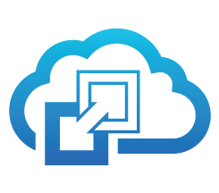
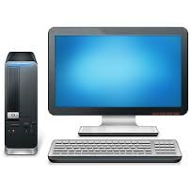
Overland-Tandberg Vision:
Enabling Organizations to Securely Manage and Protect their Digital Assets
Public Cloud
Private Cloud
Onsite Infrastructure Business Continuity and Data Protection
Hybrid Data Protection and Archive

Slide 5
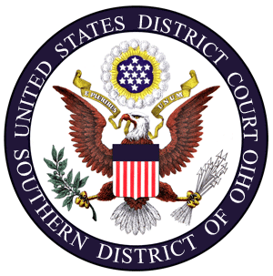
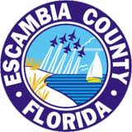
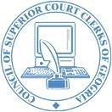
Broad Global Installed Base in Over 90 Countries
Financial Services
TMT
Industrial / A&D / Auto
CPG / Healthcare
Government / Education

Slide 6
Data Protection & Archive Market Dynamics

Slide 7
Capitalizing On Trends In Long-Term Data Storage
Volume of data being stored is increasing 50% to 120% annually
For every 1TB of data generated today, there will be 14x more by 2020
20+% of corporations store >1PB
Video surveillance will generate 2.5EB/day in 2019
Big data is here to stay
Not being able to access data costs businesses 20-35% of their operating revenue; estimated to be $600b annually
By 2020, 33% of information will be “touched” by cloud computing
Only 15% of data will be stored in the cloud
Costs can be much higher than tape
Backup/restore can be slower than tape (subject to bandwidth limitations)
Site disasters or appliance failures can result in permanently lost data
IDC Digital Universe
Wikibon
Horison Information Strategy

Slide 8
Capitalizing On Trends In Long-Term Data Storage

Slide 9
Cyber Security and Data Risk of High Concern
Top Enterprise Security Concerns
Recent Ransomware “Facts”
71% of the organizations targeted by ransomware end up infected
1 in 131 emails contains malware
4,000 ransomware attacks per day
16,700% increase of ransomware attacks
US$ 1,077 average ransom amount
300+% new variants
52% ransomware bypassed Antivirus software
Source: https://blog.barkly.com/cyber-attack-statistics-2016
Sources: Symantec Internet Security Thread Report 2017 https://www.justice.gov/criminal-ccips/file/872771/download; https://blog.barkly.com/ransomware-statistics-2016; https://blog.barkly.com/cyber-attack-statistics-2016;
Overland-Tandberg Solutions Address Enterprise Protection Needs and Concerns Today
Notes:
IT Administrators see Ransomware as one of the most cyber threats for businesses; infection via e-mail attachments
Overland-Tandberg solutions are compliant today to the EU-GDPR and provide protection against security threats like Ransomware

Slide 10
EU-GDPR: What is It?
Due to go in effect on 25 May 2018
“Most fundamental change to data protection law in almost 20 years
EU-GDPR Information Commissioner, Sept 2017
Covers the use of “personal data” – any information that can identify a living individual
Applies to:
Organization operation within European Union (EU)
Non-EU organization offering goods/services with the EU

Slide 11
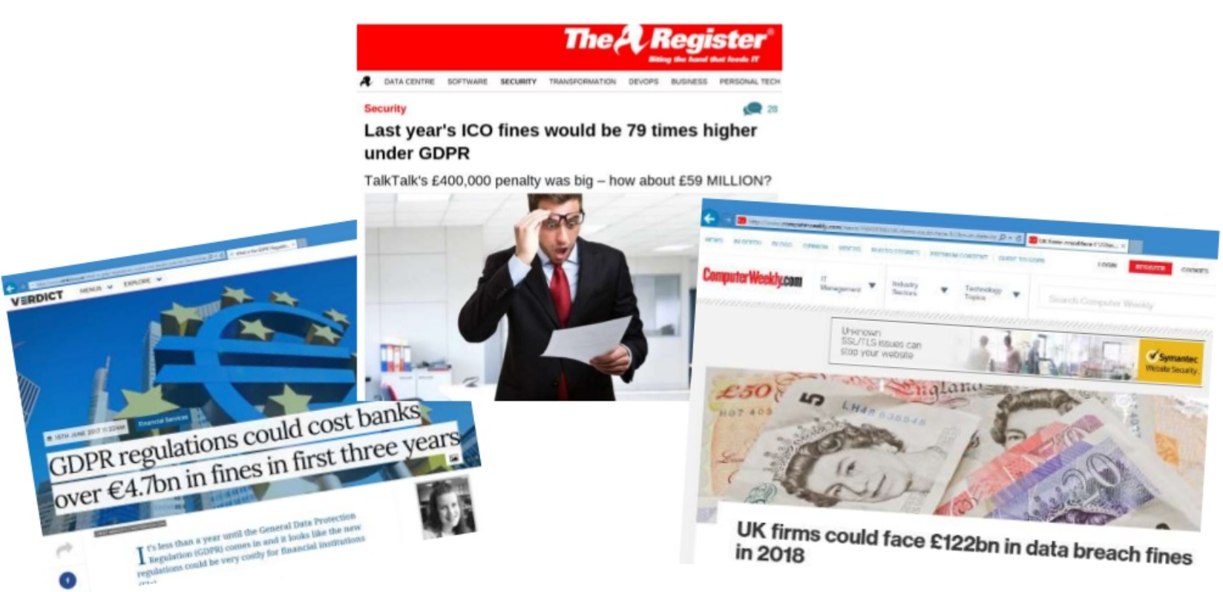
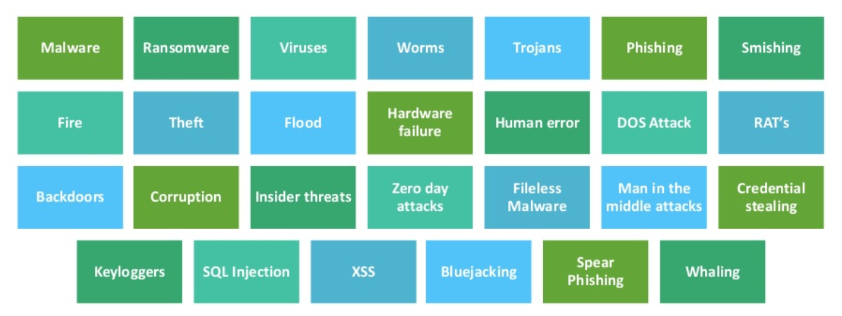
EU-GDPR: Why Does it Matter?
Non-Compliance can result in large fines
The Cyber Security Threats to Data Continue to Grow
Overland-Tandberg data protection and archive solutions are compliant today to the EU-GDPR

Slide 12
Our Products and Solutions

Slide 13
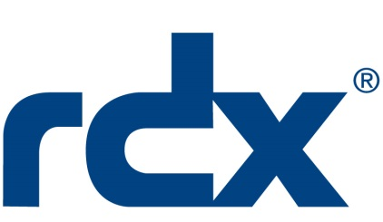
Overland-Tandberg Storage Portfolio Hybrid Data Protection and Archive
Solution
Use Case
Removable Backup / Recovery for any environment
Tape Backup / Archive & Disaster Recovery
Key Benefits
Plug & Play / Ease of Use
Ransomware Protection
Ruggedized for Harsh Environments
Products for SMBs and Large Enterprise
Low Total Cost of Ownership
Field Proven
> 4 million docks & cartridges deployed
37 patents issued / 5 pending
> 20 years of tape library deployment
16 patents issued / 3 pending
Testimonials
“Distributing large amounts of data to remote locations is more practical and economic with RDX than many other alternatives.” – Sr. Analyst, Evaluator Group
“We particularly liked the build quality and the expansive capability of the NEO tape library.” – BBC News
Common Attributes
Trusted & Reliable Hybrid Cloud Ready

Slide 14
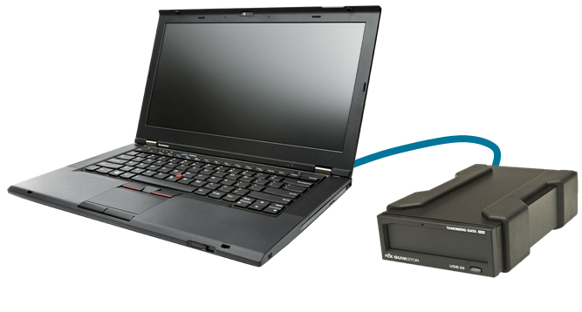
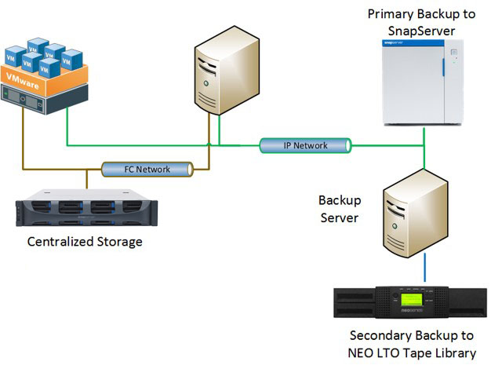
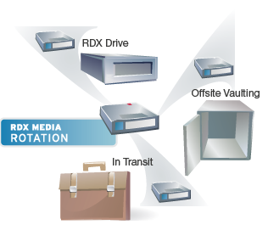
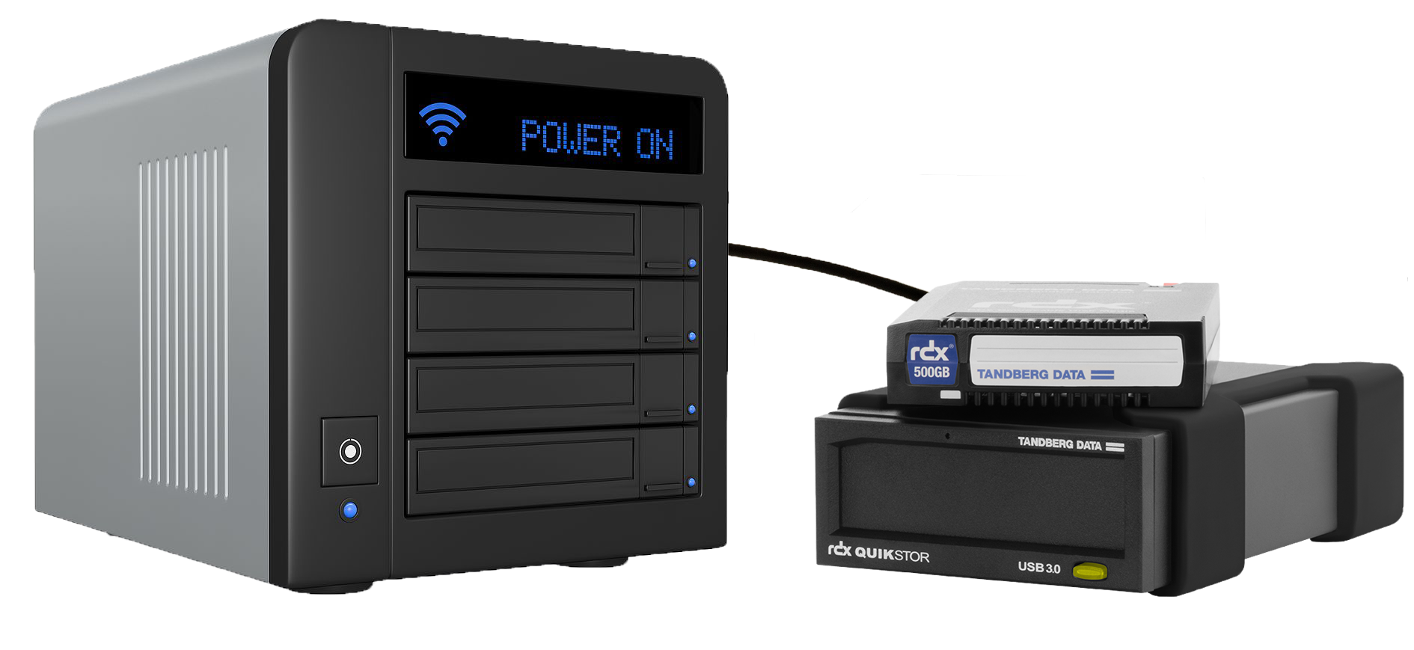
Overland-Tandberg Storage Portfolio 3-2-1 data protection best practice offering for companies of any size
SOHO to Small SMB
Simple Backup w/ Easy-to-Use RDX for Archiving
SMB to Enterprise Use Case
Primary and secondary backup to SnapServer and RDX / NEO
Laptop or desktop backup
ARCHIVE
Media Rotation
Full disaster protection with alternating usage of multiple RDX media
NAS Backup
Utilization of built-in backup routines of major NAS vendors
“3-2-1”: 3 copies of data; 2 different types of media; 1 backup offsite

Slide 15
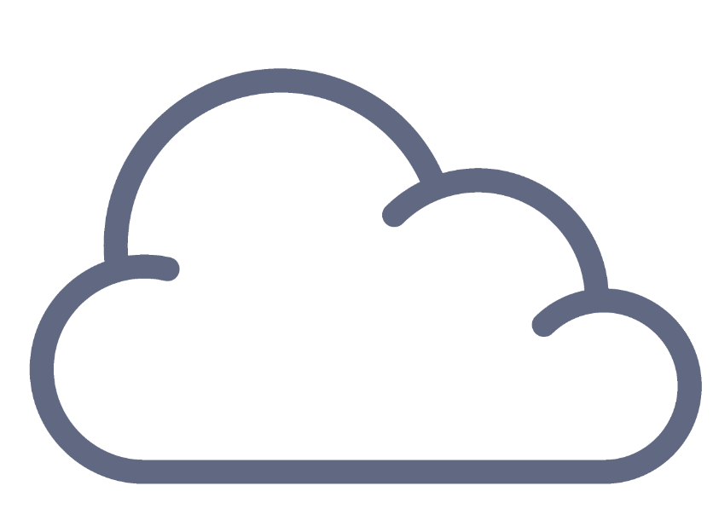
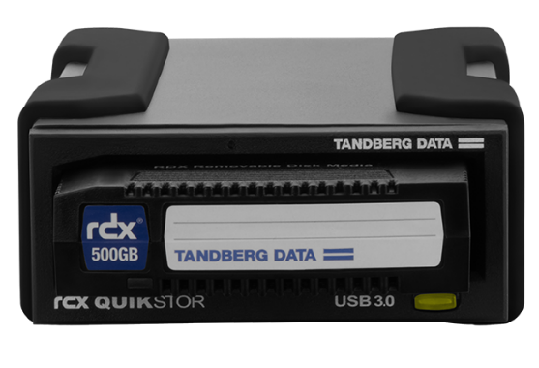
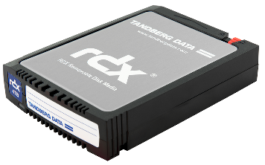
3-2-1 Data Protection: Hybrid Cloud Implementation
Computer Network
Backup Application
Backup & Archive
Notes:
RDX Hybrid Cloud Use-Case NO1
Traditional GFS Backup using 3-2-1 Backup Strategy, (have at least 3 copies of data on at least 2 Storage devices and one stored off-line and off Site)
Primary Backup Data managed by an Backup application are storage locally on RDX with media rotation and off-site storage;
add additional protection with RDX RansomBlock to protect any data from Viruses, Malware and Crypto-Locker
Secondary Backup is stored in the cloud and also managed by your preferred backup application
-your weekly or monthly backup depending on your compliance requirements.
-data is accessed infrequently which helps limiting cloud backup storage cost.

Slide 16
Customer Use Cases and Testimonials

Slide 17
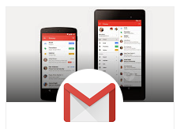
Who’s Using Tape
Ben Treynor, VP Engineering and Site Reliability Czar (24x7)@ Google
Imagine the sinking feeling of logging in to your Gmail account and finding it empty. That’s what happened to Gmail users yesterday, and we’re very sorry. I know what some of you are thinking: how could this happen if we have multiple copies of your data in multiple data centers? Well, in some rare instances software bugs can affect several copies of the data. That’s what happened here. To protect your information from these unusual bugs, we also back it up to tape.
In less than 24 hours, all data had been successfully restored from tape!
We’re a small video production company in Los Angeles, California, with a subsidiary in New York City. We generate approx. 5TB of data per day. Over a 10Mbps connection, it would take us about 7 weeks to transmit just one day of recording. Even with a 100Mbps upstream, which is cost prohibitive, it would still take about five days to transmit our data – just not fast enough.
We compared this to FedEx, where we can transmit as many tapes as we want in less than 24 hours! Tape was a no-brainer!
Notes:
In fact, a study conducted by the National Energy Research Scientific Computing Center showed that tape media cartridges are 4 orders of magnitude more reliable than SATA disk, and that tape libraries have more than five-nines level of reliability.
Additionally, when you look at the bit error rates – which are an indication of the reliability of the recording technology itself – you’ll find that tape drives have a significantly lower number of recording errors than both desktop and enterprise disk drives.
Curtis Preston sums it up well when he says that you are 100 times more likely to have bad data on disk than you are on an LTO5 tape drive.

Slide 18
Who’s Using Tape
We generate 400TB of data each month from our Genome research. Once we’ve analyzed the data we collect, we archive it all off to tape.
We chose tape because we know that no other technology can provide the price point that tape can for storing large amounts of data. We also like how easy it is with tape to share our research data between locations.
We’re a digital video company processing large amounts of high-res video. Our data backup requirements grew from 15TB to over 100TB in 1 year. We needed a solution that could not only capture video but back up our Windows server as well.
We wanted tape because we knew it had the capacity & speed we needed, the reliability & shelf life, it was very affordable, it was less complex than RAID and SAN and it was more reliable than hard drives.
Notes:
In fact, a study conducted by the National Energy Research Scientific Computing Center showed that tape media cartridges are 4 orders of magnitude more reliable than SATA disk, and that tape libraries have more than five-nines level of reliability.
Additionally, when you look at the bit error rates – which are an indication of the reliability of the recording technology itself – you’ll find that tape drives have a significantly lower number of recording errors than both desktop and enterprise disk drives.
Curtis Preston sums it up well when he says that you are 100 times more likely to have bad data on disk than you are on an LTO5 tape drive.

Slide 19
Effortless Digital Archiving
BBC manages and maintains a vast online library of digital photographic images. These archives are accessible to all employees via the BBC global intranet network and play an extremely important role in the preparation of daily news bulletins. Images in the system, for example, are regularly used by the television news teams and on the Web to illustrate the day's stories.
“We particularly liked the build quality and the expansive capability of the NEO tape library.”

Slide 20
Backup And Archive You Can Count On
When the Salk Institute needed more backup and archive capability, they turned to the NEO Series from Overland Storage. Salk originally came to Overland when it came time to replace the tape library they had bought from another vendor. Backing up 100TB of data a day meant they needed a powerful solution that could house the massive amounts of data generated by their scientific community. When Salk added a second NEO 8000 to their data center, they didn’t even consider other solutions since NEO had proved to be the solution they could count on.
“The reliability, flexibility and scalability of the NEO solutions are why we selected Overland ... providing a significant cost savings for us now and in the future.”

Slide 21
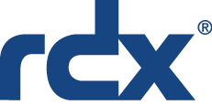
Customer Case Studies – Medical End-Market
CGM MediStar
Background:
CGM MediStar is a group of System Integrators serving the medical market primarily in central Europe but also world-wide for doctor offices, dentists, pharmacies, hospitals, etc.
RDX one of the Backup Storage devices they use with their customers
Solution:
80% of all their pharmacies in Germany are doing backup to RDX every day, a full backup using either Microsoft Windows Backup or NovaStor Backup
Typically 30% of this installed base gets equipped with new RDX drives and media each year

Slide 22
Customer Case Studies – Law Enforcement / Military
European Police Case Study 1**
1,500 police stations are backing up their data to RDX in a European Country
Doing scripted backups to RDX Media with Microsoft Windows backup
Department of Defense**
A RDX QuikStation 8 installed on each Boat and Submarine used for backups of the “swimming” computers
Particularly like the ease of use, robustness and product quality of RDX, which they’re using to replace failing tape systems
International / Multi-Country Agency**
Pilot Project delivered in 2017. 350pcs RDX internal SATA III + 500pcs 1TB RDX Media
Agency using RDX in high security environments to boot desktop computers independently of any networks infrastructure with user specific information stored on RDX Media. And when the work is done on that system the RDX Media is put in a vault for security reasons when they shutdown the PC.
Pilot is running in a test phase and if that is passed they will plan to roll it out to a total of 7,000 desktop computers throughout the agency.
**Due to confidentiality and security reasons, customer name and win are not disclosed publicly

Slide 23
Customer Case Studies – Hospitality End-Market
Background:
Industry Leading Hotel Brand** is doing a backup of daily server and video surveillance data to RDX
Deployed and sold through Authorized Overland-Tandberg Partner and System Integrator
Deployments started in 2013
Corporate mandated as the archive solution for every site worldwide
Currently deployed in over 5,000 hotel properties
Solution:
One to two RDX drives per hotel location
Daily back up to 1 RDX media cartridge per location
At day end, RDX media cartridge taken to off-site / central location for archiving / disaster recovery planning
**Due to confidentiality customer name not disclosed publicly

Slide 24
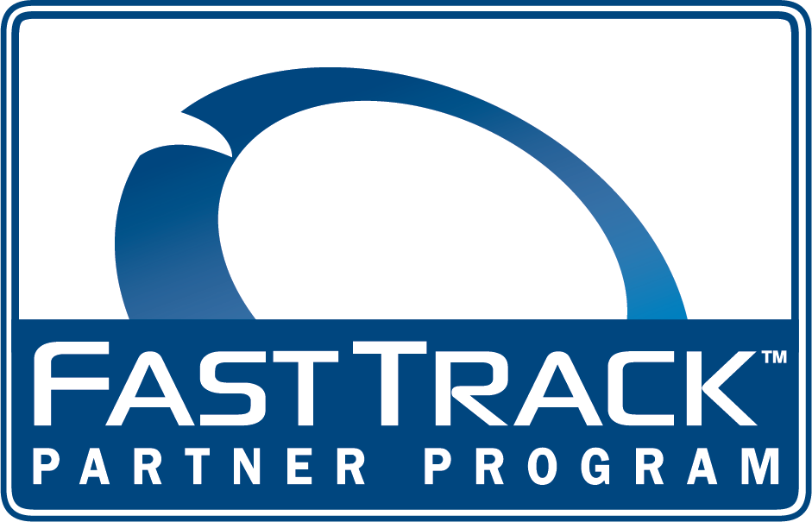
FastTrack Channel Partner Program

Slide 25
FastTrack Program Delivers…
… the necessary sales and support tools, educational content, marketing programs, promotions and sales protection for partners who deliver outstanding value and demonstrate an on-going high level of commitment to the Overland-Tandberg portfolio of products.
Learn more at:
http://www.overlandstorage.com/partners/

Slide 26
FastTrack Benefits Summary
FastTrack Partner Program Benefits
Access to online collateral
Continuing education programs
Dedicated inside sales representative
Eligibility for market development funds
Joint marketing campaigns and events
Deal registration and protected margin
Partnering opportunities for national and regional shows
Phone and online support
Authorized to sell Overland-Tandberg storage products (RDX® NEO®, SnapServer®)
Our Self-Service FastTrack portals require signed terms and conditions. Once signed, partners are welcome to purchase all Overland-Tandberg products from any authorized distributor granting access to resell NEO, Snap, and RDX solutions.

Slide 27
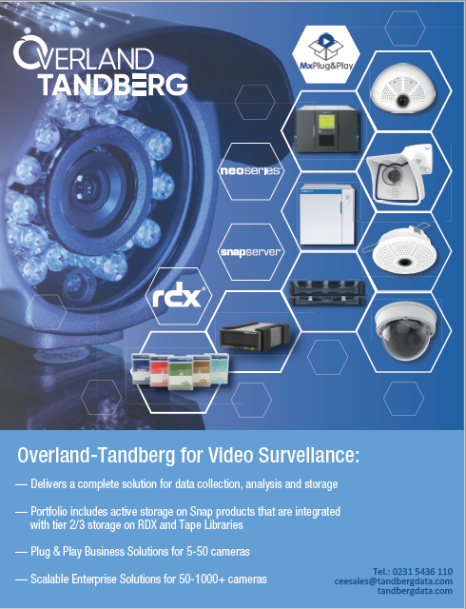
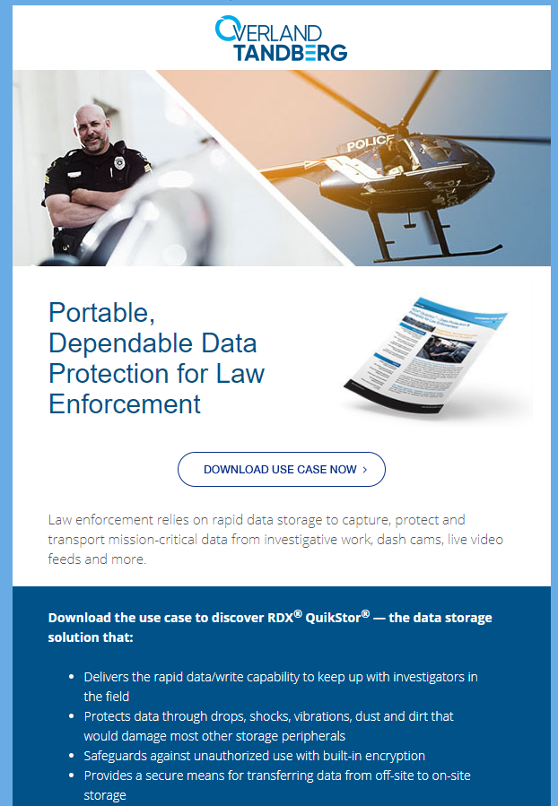
FastTrack Enablement Activities
Web-based content syndication
Template collateral
Success stories
White papers
Testimonials
Customizable collateral
Demand generation
Call scripts
HTML
Executive door openers
Joint Marketing
In-Person events
Webinars
Demand generation campaigns

Slide 28
Summary

Slide 29
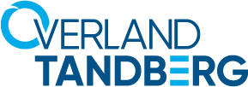
Summary
Storage and backup via Hybrid Cloud for enterprises of all sizes
Provides the trusted safety and security your enterprise requires at every price point and every use case, whether delivered on-premise, via public cloud, or Hybrid Cloud.
Innovation and strong patent portfolio with 79 issued patents, 31 pending
Worldwide reseller channel in over 90 countries
Partnerships with tier one OEMS and strategic industry leaders
Proven technologies with over 1 million installations worldwide
Over 40 year legacy of technology leadership
Learn more at www.overlandtandberg.com

Slide 30
Thank You
www.overlandtandberg.com

