Slide 1

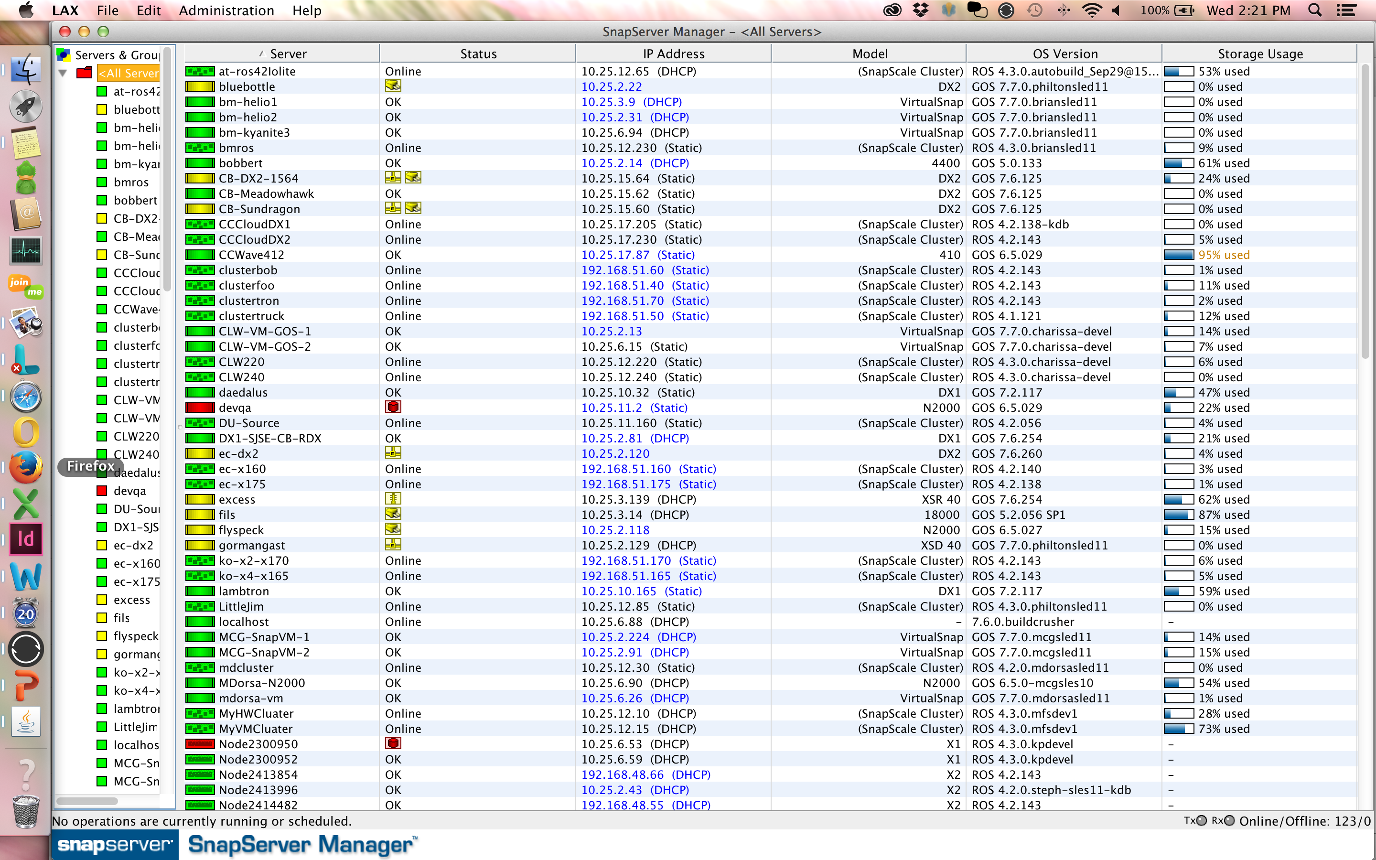

Sphere3D: Hybrid Cloud Solution
Solution Pitch
Snap Storage product line is uniquely positioned to offer unified block and file storage that is workload optimized and available for both on-premise and in the cloud.
The cost savings come from
Integrated Replication features built-in ($4K-20K in value)
Lower $/GB in workload optimized class of storage (50% less than NetApp, Dell, EMC)
Built-in Sync functanility to enable enterprise class Private Cloud (10K-100K in value)
Integrated Unified Management (saving 1+ headcount in IT)
The competitive uniqueness comes from
The Snap volumes can grow or shrink on demand with no IT intervention
DynamicRAID automatically optimizes RAID levels as drives are added to the storage pool
Replicate data between Snap, Windows, Linux and UNIX servers
Access, copy, or restore files anywhere by syncing servers and devices
SnapServer Value to End Customer
“Just-in-time” capacity, start small, pay as you grow both on-premise and cloud storage
Secure Access to data anywhere anytime
DynamicRAID storage services with single or dual parity for data protection and automatic storage pool growth
Consolidate servers and support virtualization initiatives by having block and file-based data on a single node
No wasted space, handles mixed drive capacities
Easy management with storage put into common pools
High performance snapshots for continuous data protection
Distributed replication and disaster recovery
Integrates into any existing security environment
Field Sales Battle card
Free
Single Mgmt Pane for all Snap
SnapStorage Manager
  Sales Resources:
  Product Information http://sphere3d.com/snapcloud/, overlandstorage.com/snap
  Customer Webinars http://www.overlandstorage.com/resource-center/webinars/index.aspx
  Sales Playbook on FastTrack https://overlandstorage.secure.force.com/fasttrack/
Ent. Apps
Expandable storage
File & Block
SnapServer
Complimentary Products
Backup: Neo tape libraries and RDX QuikStor
IP Video Surveillance: Mobotix MxCC Integration
Secure Private Cloud: BitTorrent® Sync
Infinite storage
Self-learning
Self-healing
SnapScale
Qualifying Questions
How much storage will be used for?
  File sharing?
  Backup?
  Disaster Recovery?
  Databases?
  Video Surveillance?
Do you have any performance requirements for the storage?
Do you have multiple locations that require data protection and disaster recovery?
What other storage vendors are you looking at?
Interest Generating Questions:
Are you deploying applications on Azure that need enterprise-class NAS storage?
Are you looking for efficient, cost-effective and flexible technology solution alternatives to your current Disaster Recovery solutions?
Are your employees using Dropbox, Boxnet or other public cloud solutions to enable secure data access on mobile devices?
Are you looking to lower costs through reducing your data center footprint?
Primary datastore
$0 upfront cost
Cloud DR
SnapCLOUD
File shares
Quiet
Economical
XSD40

