Slide 1


Private & Hybrid Cloud on Snap Storage
February 2016

Slide 2
Interest Generating Questions
Internal ONLY
CEO
Is your IT infrastructure meeting your business objectives? (exapmle: growing fast enough, making your employees more productive)
What are your long term and short term top priorities?
COO/IT Head
What is your storage spend? How much data growth are you experiencing? What are your top operational challenges?
Our research shows that 70% of businesses don’t survive a disaster resulting in data loss as they don’t have a second copy of data offsite. What is your disaster (floods, fire, earthquake..) recovery strategy? >> EDR, CR, SnapCLOUD
Majority of businesses need secure access to data outside the physical office or need to share data with partners and customers that is secure and tightly controlled? What tools do you use to share data? >> SnapSync
A single unified storage management solution can reduce storage admin headcounts significantly. How many different tools do you have today to manage all your storage infrastructure? >> Snap Portfolio with SnapStorage Manager
What do you do when you are running out of storage space? What if you had an infinite pool of storage that could start small and grow non-disruptively? >>SnapScale
How often are you refreshing your storage hardware? Does that require downtime? What if all the hardware, software upgrades where non-disruptive? >>SnapScale
Distributed Enterprise >> SnapServers

Slide 3



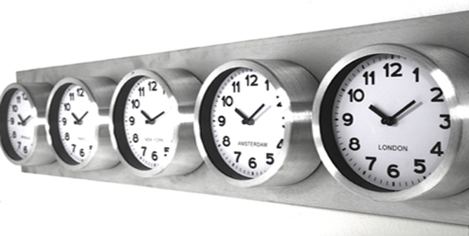

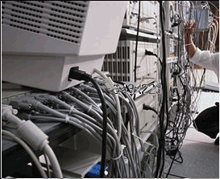

Critical Juncture for Business
Option A
Economic Uncertainty
Anytime Any device
Business Continuity
Business Pressures
Operational Pressures
Legacy Apps & Aging Infrastructure
Management Complexity
Risk Mitigation

Slide 4
Sphere 3D Delivers End-to-end Solution
Any Applicatons
3 YEAR TCO
50%
+80%
Line of Business Modernization
2-5X
75%
Application virtualization and mobility
Deliver legacy apps on to latest HW Infrastructure
Move CAPEX to OPEX w/ Hybrid Cloud
LOWER
LOWER
INFRASTRUCTURE COST
LOWER
APP MGMT COST
BETTER APPLICATION SCALING
Any Device
46%
20%
75%
Workspace Modernization
2-5X
LOWER
BYOD and workspace virtualization
End-point computing near users
On-demand resource scaling
LOWER
INFRASTRUCTURE COST
LOWER
WORKSPACE MGMT COST
BETTER APPLICATION PERFORMANCE
Cloud Enabled Storage
Data Storage Transformation
60%
+80%
16X
70%
Workload optimized, cloud ready storage
Secured data access, anywhere, on any device
Reduce footprint for active and retained data
LOWER
LOWER STORAGE
INFRASTRUCTURE COST
COST OF CENTRAL MGMT & REPLI SW
FASTER
FILE SHARING SW
AT NO EXTRA COST

Slide 5
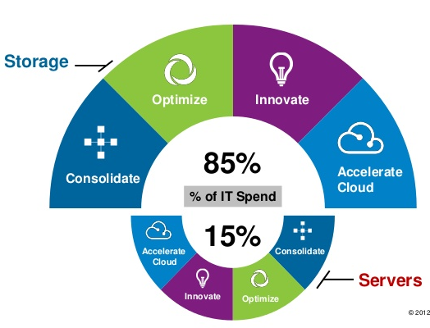
Importance of Storage in IT Infrastructure
Option B
High Infrastructure Cost Storage is a significant % of IT Infrastructure
Optimized for workload is leads to silos and complexity
Consolidation of on-premise & cloud management tools can eliminate expensive skilled expertise
Mobility and secure data sharing enables enhanced productivity & collaboration.
Accelerate Cloud for data center on demand and pay for what you use
Mobility
<50%
>50%
Rest of IT Infrastructure

Slide 6




Sphere3D’s Snap Technologies enable
Simple. Integrated. Innovative.
Cloud storage
MOBILE
SNAPSync
Desktop storage
SNAPCLOUD
CLOUD
SMALL/HOME OFFICE
Scaled NAS storage
SNAPSERVER
XSD
PRINT
SERVER
SNAPSCALE
High Perf.
Apps
On-premise storage
BRANCH/SMALL OFFICES
SNAPSERVER
VIRTUAL
MACHINE
HEAD OFFICE
Common Attributes
Data Mobility Centralized Management Hybrid Cloud Ready
Data Mobility | Centralized Management | Hybrid Cloud Ready
SnapSync | SnapStorage Manager | EDR, Continuous Replication Non-disruptive Expansions, Dynamic RAID

Slide 7
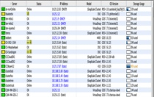

Snap Storage Portfolio
Operational Efficiency
Consolidate Management
SnapStorage Manager - Online, Integrated, user experience focused
Operational Simplicity
Common core capability delivers standardized user experience
Failure Resiliency
Space Saving
Mobility
Disaster Recovery
Security
Workload
Optimized
Tech/Eng Apps
Enterprise Apps
File Shares
Cloud Store
SnapScale
SnapServer XSR
SnapServer XSD
SnapCLOUD
Workload
Specific
High Throughput
Infinite storage
Self-healing
High IOPS & low latency
Expandable
Tier-ed
Moderate IOPS
Quiet
Economical
Guarantee SLA
$0 upfront cost
Cloud DR
Notes:
Here is where the Snap Storage Family strengths really shine. The entire storage family consists of products that have been architected to be optimal for specific workloads. SnapScale offers a single infinite pool of storage and is optimized to seamlessly scale to deal with the relentless growth of unstructured data with a self-learning, self-healing architecture that also scales infinitely for performance. SnapServers specialize in business applications that are very low latency. While SnapCLOUD offers enterprise class storage features for primary data storage in the cloud with zero upfront investment.
While offering workload optimized functionality that varies across each product line – they share a common set of features that you would expect from any enterprise class product like failure resiliency to hardware failures, space saving technologies like thin provisioning, space efficient and high performance snapshots, snapshot pruning, secure controlled access to data with Active Directory integration. 3 common mechanisms for replication making it easy to move data between products or setup disaster recovery sites. The best news for any IT admin is that all the Snap storage products can be managed from a single unified management interface. So while you as a customer gets to deploy workload optimized products you are not creating infrastructure silos and that is nirvana.

Slide 8
TCO Analysis
Sphere3D vs. Leading Storage Vendor
Workload
Optimized
SMB / Remote Office
File Shares
Enterprise
Business Apps
Nearline / Offline
Backup & Archiving
SnapScale
NEO Series
Platform
SnapServer
XSD
Vs.
Synology
QNAP
SnapServer
XSR
Vs.
NetApp
FAS
SnapScale
Vs.
EMC Isilon
Infrastructure
Cost
-20%
(5 9s availability)
+ 60%
(Reduced HW + Incl. SW)
+ 54%
(Reduced HW + Incl. SW)
Data sharing & mobility
+ 74%
(Eliminate Dropbox like)
+ 74%
(Eliminate Dropbox like)
+ 74%
(Eliminate Dropbox like)
Common Tools & Management
+ 40%
(Reduced IT staff time)
+ 36%
(Reduced IT staff time)
+ 38%
(Reduced IT staff time)
Total
% Savings
50%
58%
54%

Slide 9
Product | Key Features | Functions | Business Benefits
Snap Storage Manager | Simple Intuitive Online GUI User experience focused | Consolidated Management of SnapServer, SnapScale & SnapCLOUD | +Operational Simplicity & Efficiency + Headcount reduction by 40%
SnapScale | Peer-set Architecture Non-disruptive hardware & software refresh | High Throughput Infinite storage Self-healing, self-learning | +Gain productivity with zero downtime (planned or unplanned)
SnapServer | Unified block & file, LDAP & AD Integration, Dynamic RAID, Tiering, Expands from 4TB to 576TB | Integrates with any enterprise app low latency Non-disruptive expansions Space Reduction | +High Performance and low latency at 60% lower infrastructure cost. +Reduce skilled IT needs with integration & simplicity. +Pay for what you need.
SnapSync | Intelligent Sync, Folder level access control, On-demand access Files, Mobile device backup | High speed sync, Change permissions at any time, designate other users as owners, protect data | +Build your own cloud @ 75% less+Security integration +Save bandwith costs. +Reduce impact of mobile device loss
SnapCLOUD | Unified block & file, Guaranteed SLA, On-demand expansion from 1GB-16TB | Integrates with any enterprise application, Non-disruptive expansions No on-premise infrastructure required | +Manage risks with low operational expenditure +Pay for what you need.
Snap Data Protection | EDR & Continuous Replication | Near zero recovery point and time objective Bandwidth optimized - change based Interoperability in Snap Storage Portfolio | + No loss of information + Reduced impact of unplanned downtime, disasters
Notes:
Here is where the Snap Storage Family strengths really shine. The entire storage family consists of products that have been architected to be optimal for specific workloads. SnapScale offers a single infinite pool of storage and is optimized to seamlessly scale to deal with the relentless growth of unstructured data with a self-learning, self-healing architecture that also scales infinitely for performance. SnapServers specialize in business applications that are very low latency. While SnapCLOUD offers enterprise class storage features for primary data storage in the cloud with zero upfront investment.
While offering workload optimized functionality that varies across each product line – they share a common set of features that you would expect from any enterprise class product like failure resiliency to hardware failures, space saving technologies like thin provisioning, space efficient and high performance snapshots, snapshot pruning, secure controlled access to data with Active Directory integration. 3 common mechanisms for replication making it easy to move data between products or setup disaster recovery sites. The best news for any IT admin is that all the Snap storage products can be managed from a single unified management interface. So while you as a customer gets to deploy workload optimized products you are not creating infrastructure silos and that is nirvana.

Slide 10
Summary
Innovative technology can help you modernize your business to fuel growth and develop a competitive edge while lowering your
Reduce IT Spend
While data continues to grow, the IT staff managing it remain relatively constant. So they need to get very efficient. This creates a need for an end-to-end solution managed with a single tool. This will increase IT staff efficiency and lower expertise required. Add the cloud readiness to this architecture to reduce capital investments and land on a pay for what you use model. Because growing is non-disruptive & seamless
Always Stay Open for Business
You only make money when the lights stay on. But unforeseen events can happen. Your business data must be safe and normal operations must return in a flash. No exceptions! Don’t be caught without a data protection solution
Take Your Business With you
Your customer data is your business. You need access to it all all times in the office or at remotes sites. It’s all about increasing productivity and the level of customer satisfaction you can deliver.

Slide 11
Private & Hybrid Cloud on Snap Storage
February 2016

Slide 12
SnapServer XSR/XSD
Core Features | Function | Benefits
Enterprise-grade Unified Storage solution with file (NFS, SMB/CIFS) and block (iSCSI) protocol, and native Microsoft AD integration | Robust enterprise grade unified storage appliance scales up from 2TB to 786TB. Integrates seamlessly, including mixed (Unix/Windows) permissions in a MS Active Directory domain. | Either SMB, a ROBO or a large corporate workgroup, SnapServer meets need for all From shared storage to enterprise application data, SnapServer does it all, including mixed workload Seamless integration in corp IT including hybrid cloud across mixed user between Unix, Linux and windows
Built in resiliency with DynamicRAID technology with data tiering and mixed drive support | Create, grow and shrink volumes for users or groups dynamically. Support tiered storage with mix of SSD and SATA. Mix drive sizes without sacrificing capacity | Maximize your storage efficiency by granularly allocating and utilizing your capacity across drive types and sizes – no wastage Overprovision and optimize workload performance
Built-in near synchronous data replication for business continuity | Copy your original data and subsequent changes to another Snap family appliance using the built-in parallel replication engine. Set up granular backup scheduling as needed- hourly, daily, etc. | Enjoy peace of mind with data availability in case of system or site failure. No additional cost for the replication feature means you save thousands of dollars in SW cost
Build a hybrid cloud with SnapCLOUD | Integrate and replicate data on to SnapCLOUD, and ensure business continuity and DR against site level failure. | Enjoy cloud based DR with SnapCLOUD. Common features and tools across Snap family reduce complexity and cost of managing a hybrid cloud.
Set up a private cloud with SnapStorage Manager and SnapSync | Centrally manage all the Snap family appliances with SnapServer Manager. Securely Sync and share files between end-users and devices. | Keep all your corporate data in your control and protected in a private cloud. Sync and share data with users and their devices with Dropbox like simplicity but not cost.

Slide 13
SnapServer
Feature | Function | Benefit
NAS/SAN | Files, virtualization, databases, etc. structured and unstructured dara | One destination for all your applications
Scalability | 2TB to 768TB | Scale as you grow no forklift upgrades
Tiering | Mixing different data drive speeds | Optimized for price/performance
Thin Provisioning | Over provision | Dynamic space allocation
Dynamic RAID | Mix drive sizes | Upgrade hw with high utilization and non-disruptively
Replication | Copy data for secondary storage Encrypted | Always on, business continuity, no additional cost No VPN needed
Snap Manager | Single Pane of glass for management | Reduce operational cost
Snap Sync | Encrypted replication, Selective sync with bandwidth and space reductions | Secure access to data anywhere, from any device. Network cost savings Access to unlimited data on a limited device memory
Services & Support | Global phone support, default advanced replacement, 24*7, enterprise class, 4 hour SLA, phone support | Ensure business continuity https://www.synology.com/en-us/company/legal/warranty read 2.3 to 2.5
Data Import | Import data from a competitive, legacy | Save time, money and resources in data migration
High Availability | Operations data shows 5 9s availability | No downtime for 3+ years,
Hybrid Cloud | Extension of on-premise data storage infrastructure | Pay as you go

Slide 14
Sphere 3D’s Private Cloud

Slide 15
SnapServer XSR/XSD
Core Features | Function | Benefits
Enterprise-grade Unified Storage solution with file (NFS, SMB/CIFS) and block (iSCSI) protocol, and native Microsoft AD integration | Robust enterprise grade unified storage appliance scales up from 2TB to 786TB. Integrates seamlessly, including mixed (Unix/Windows) permissions in a MS Active Directory domain. | Either SMB, a ROBO or a large corporate workgroup, SnapServer meets need for all From shared storage to enterprise application data, SnapServer does it all, including mixed workload Seamless integration in corp IT including hybrid cloud across mixed user between Unix, Linux and windows
Built in resiliency with DynamicRAID technology with data tiering and mixed drive support | Create, grow and shrink volumes for users or groups dynamically. Support tiered storage with mix of SSD and SATA. Mix drive sizes without sacrificing capacity | Maximize your storage efficiency by granularly allocating and utilizing your capacity across drive types and sizes – no wastage Overprovision and optimize workload performance
Built-in near synchronous data replication for business continuity | Copy your original data and subsequent changes to another Snap family appliance using the built-in parallel replication engine. Set up granular backup scheduling as needed- hourly, daily, etc. | Enjoy peace of mind with data availability in case of system or site failure. No additional cost for the replication feature means you save thousands of dollars in SW cost
Build a hybrid cloud with SnapCLOUD | Integrate and replicate data on to SnapCLOUD, and ensure business continuity and DR against site level failure. | Enjoy cloud based DR with SnapCLOUD. Common features and tools across Snap family reduce complexity and cost of managing a hybrid cloud.
Set up a private cloud with SnapStorage Manager and SnapSync | Centrally manage all the Snap family appliances with SnapServer Manager. Securely Sync and share files between end-users and devices. | Keep all your corporate data in your control and protected in a private cloud. Sync and share data with users and their devices with Dropbox like simplicity but not cost.

Slide 16
SnapServer Competitors
 | Sphere3D XSD/R | Dell NX-Series | Synology 2415/1416 | NetApp FAS2520
System
Max Capacity | 768TB | 192TB + SAN expansion | 144TB | 576TB
Entry price point | Sub $1000 | $3000+ | Sub $1000 | $5000+
Form factor scale | Table top to 2U Rack mount | Rack mount only | Table top to 2U Rack mount | Rack mount only
SOHO/Branch office use case |  | - |  | -
Enterprise use case |  |  |  | 
Noise free / Quite mode operation |  | - |  | -
Storage SW features
Storage operating system | Guardian OS | Windows2012 | Disk Storage Manager | Data ONTAP
High performance snapshot |  | - | - | 
Self Balancing |  | - |  | 
Self provisioning |  | - |  | 
Data Mobility and Data Migration
Built in data migration capability from heterogeneous storage arrays |  | - | - | -
Built-in sync and share capability between storage systems and end-user devices |  | - |  | -
Cloud integration
Virtual primary storage instance in the Cloud |  | - | - | 
Replication
Continuous Replication |  |  |  | 
High Performance – Near Sync |  | - |  | -
Remote & Central Office Solutions
Data Replication between scale up and scale out storage products for distributed enterprise |  | - | - | -
Single management between Scale-out NAS and cloud based instances |  | - | - | -

Slide 17
SnapScale X2/X4
Core Features | Function | Benefits
High performance scale-out Cluster file system with NFS and SMB/CIFS protocol and self balancing data layout | File services that scale linearly and deliver multiple GB/s throughput performance, while growing non-disruptively as you add drives and nodes. Data gets distributed evenly across nodes automatically, | Improve employee productivity - Get more high performance tasks done in shorter amount of time Scale as your needs grow - Start small (12 drives) and grow to 100s of PBs Self balancing ensures consistent performance across all the workloads and users
Built in resiliency with Peer Set Protection technology | Automatic data protection with built-in redundancy across multiple nodes and disks | No service disruption even if multiple drives fail (traditional RAID can’t survive more than 2 failed drives) Over 3x faster rebuild times on replaced drives
Built-in near synchronous data replication and Data Migration capability | Copy your original data and subsequent changes to another SnapScale cluster at very high speed using the built-in parallel replication engine. Data import feature enable ease of migration from heterogeneous NAS. | Enjoy peace of mind with data availability in case of system or site failure. No additional cost for the replication feature means you save thousands of dollars in SW cost No need to spend extra for data migration project.
Build a hybrid cloud with SnapCLOUD | Integrate and replicate data on to SnapCLOUD, and ensure business continuity and DR against site level failure. | Enjoy cloud based DR with SnapCLOUD. Common features and tools across Snap family reduce complexity and cost of managing a hybrid cloud.
Set up a private cloud with SnapStorage Manager and SnapSync | Centrally manage all the Snap family storage appliances with SnapServer Manager. Securely Sync and share files between end-users and devices. | Keep all your corporate data in your control and protected in a private cloud. Sync and share data with users and their devices with Dropbox like simplicity but not cost.

Slide 18
SnapScale Competitors
 | Sphere3D | Dell-Compellant | NetApp-FAS | EMC-Isilon
Scale
Maximum Cluster Capacity | Over 500PB | 24PB | 103PB | 20PB
Maximum Volume Size | Over 500PB | 100TB | 100TB | 20PB
Maximum Number of Nodes | 64000 | 8 | 24 | 144
Clusterwide Global Namespace |  | - | - | 
Storage Growth
Smallest Cluster Size | 12 Drives | Not Specified | Not Specified | 36 Drives
Auto Data Balancing |  | - | - | 
Auto Performance Balancing |  | - | N- | 
Data Mobility and Data Migration
Built in data migration capability from heterogeneous storage arrays |  | - | - | -
Built-in sync and share capability between storage systems and end-user devices |  | - | - | -
Cloud integration
Replication with cloud instance |  | - |  | -
Fault Tolerance
Number of Drive Failures Tolerated before losing data access | 50% of Drives | 2 in RAID group | 2 in RAID group | 2 in storage pool
Node Failures Tolerated | Upto 2 | Upto 1 in HA pair | Upto 1 in HA pair | Varies
Replication
Continuous Replication |  |  |  | 
High Performance – Near Sync |  | - |  | -
Seamless integration between Remote Office & Central Data Center
Data Replication between different storage products |  | - | - | -
Single management between entry NAS, ROBO and cloud based instances |  | - | - | -

Slide 19
SnapSync
Core Features | Function | Benefits
Create your personal storage cloud for any time access | Once all your personal devices (from laptops and phones to storage devices like a NAS device) are linked together – via a private identity – all of your shared folders are available to you, wherever you need them. | Access all of your synced files from your iOS, Android or Windows Mobile device. Keep files on your mobile devices backed up by syncing photos, videos, docs, pdfs and more to your desktop or NAS device. Any time access to all your content on any device in a secured, on-demand fashion.
Control folder ownership and permissions anytime | Sharing performed under stringent encrypted key control. Change access levels (Read-Only or Read & Write), make others owners of a folder, or revoke a user’s access. | As the dynamics of the team or individuals you’re sharing with changes, this lets you act in real-time.
High performance peer-to-peer technology | Sync finds the shortest path between devices when transferring data. No uploading to third party servers. Just fast, simple file syncing. Sync splits big files into small pieces and then reassembles them. Sync shares the new and changed pieces of the file rather than having to share the whole huge file every time it gets saved. | Near instant access to files and data across all your devices.
On-demand access | Folders can now be set up to access on-demand, letting you view the contents of a folder and only consume the files you need. | Preserve the storage capacity of your devices, while having access to all your folders on all your devices. Choose to download only on WIFI and reduce your cellular data bandwidth cost

Slide 20
Building a Private Cloud w/ SnapSync
SnapSync – Building a private storage cloud
Faster, more secure compared to alternatives
  SnapSync enables secure and easy access, and automated sync of data among devices and users.
  Eliminates risk of malicious use of confidential information stored in public clouds.
  Supported across the Snap family– SnapServer, SnapScale and SnapCLOUD
  A proven peer-to-peer technology; 16x faster than Dropbox,
  Encrypted key based access – avoids risk of link based sharing that is common in public cloud service like Dropbox
  Data always under the control of corporate IT – Data access privilege can be removed or altered as needed
  Licensed per storage appliance regardless of number of users and amount of capacity shared.
  SnapSync client available for mobile and desktop clients
  Native feature in all Snap family storage appliances
Five Simple steps to a private cloud
Economic Benefit: 35%-75% lower Cost
  Purchase a SnapSync license for any of your existing or new Snap family storage appliance.
  Download SnapSync client application to all the end-user devices to which you want to share the data
  From the Snap utility on your SnapStorage Manager go to SnapSync and add the folder(s) you want to share
  From each folder, send access key to all the users with whom you need to sync and share the data
  Approve user’s access upon them accepting the key, and you are all set with your private cloud
Cost comparison - File sharing and private cloud
 | SnapSync | Dropbox
 | Per Month/ Per user | Per Month/ Per User
2TB (0.5TB/User) | $8.90 | $15
24TB (1TB/User) | $3.40 | $15
100TB (1/TB User) | $9.50 | $15

Slide 21
Reference

Slide 22





Glassware Competitors
 | XenApp | AppVolumes | RemoteApp |  | Nano
Application Virtualization |  |  |  |  |  | ●
Native Windows Application Streaming | ● | ● | ● |  |  | ●
Direct access to hardware drivers |  |  |  | ● | ● | ●
Hypervisor-less |  |  |  | ● | ● | ●
Containerization |  |  |  |  |  | ●
Leverage container technologies to deliver solution |  |  |  | ● | ● | ●
Microsovisor available within containers to deliver non-native OS options |  |  |  |  |  | ●
Containerize native Windows Apps |  |  |  |  |  | ●
Native Install |  |  |  |  |  | ●
Support for Desktop OS 16, 32, 64 bit applications |  |  |  |  |  | ●
Installed applications available across cluster | ● | ● |  | ● |  | ●
Use native install to deliver apps |  |  |  |  |  | ●
Management |  |  |  |  |  | ●
Applications delivered from best suited resources available in cluster |  |  |  |  |  | ●
Management across geographies leverages location and available resources |  |  |  |  |  | ●
Web based UI for installing apps |  |  | ● |  |  | ●
Utilization |  |  |  |  |  | ●
Reuses resources already running while isolating sessions |  |  |  | ● | ● | ●
Leverage local system resources for performance |  |  |  | ● | ● | ●
At least 10x more efficient then other options |  |  |  |  |  | ●

Slide 23
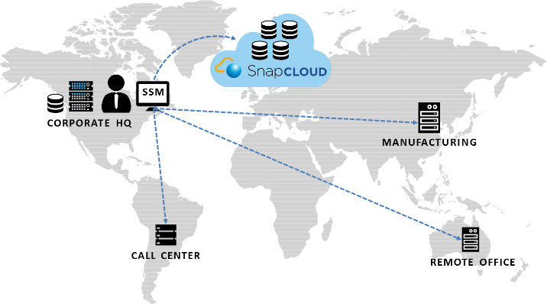
Customer Benefits
SnapCLOUD on Microsoft Azure Cloud
IT Resources On Demand
Secure Access. Anywhere. Any Device.
Centralized Management
  With SnapCLOUD, dynamically expand storage into the cloud with the same features and operations as on-premise storage. Pay for only what you use.
  SnapCLOUD enables secure and easy access to data among devices and users. Eliminates risky sharing of confidential material in public clouds.
  Snap Storage Manager enables management of all Snap Storage products through a single pane.
Notes:
At launch, we will focus on a couple of key scenarios that make sense for SMB customers and simplify the opportunity for our VARs.
Here are three great examples of how to offer profitable new services built on Microsoft Azure.
Offer data backup in the cloud – this is our lead scenario
With Azure, you can provide easy, scalable data backup in the cloud for a range of applications, such as file servers, SharePoint, SQL Server, and Exchange. For improved data protection, you can offer encrypted backups and know that data is backed up on Azure’s global geo-redundant datacenters. You also have the flexibility to quickly and easily provision more storage for your customers as needed.
Deploy applications within virtual machines
Azure also opens up the opportunity to help customers deploy applications in the cloud by hosting them in Azure VMs. Windows Server 2003 End of Life is on July15th, 2015. This presents a huge opportunity to drive the IaaS scenarios. With Azure, applications can be deployed quickly by moving them into an Azure VM. There are no up front infrastructure costs, you reduce IT management, and the application has scale up or down as needed.
Host websites on Azure – this is more of a niche scenario for partners that host websites
Microsoft Azure also offers a perfect platform for leveraging the cloud to deploy scalable websites. Hosting a website on Azure means that infrastructure management is covered, and you and your customers get the peace of mind from leveraging Microsoft’s global network of managed datacenters.

Slide 24
What is SnapCLOUD?
Features | Benefits
Unified Storage SAN/NAS - Both block and file NFS exports NFS host access control, NFS LDAP authentication CIFS/Samba/Windows shares | Flexibility to work with any application
Optimization of resources Thin-provisioning | Reduce storage cost. For example if you have 10 users each assigned 1TB of storage with utilization varying from 10GB to 500GB. Then you can deploy 4-5TB of storage and save over 100% in costs.
Space savings by using storage layer protection | Reduce storage costs by 40%
Data Protection Storage snapshots, Automatic snapshot pruning, High performance snapshots | Enterprise-class data protection suite. Same level of protection ason-premise storage
Expandable storage | Pay for only what you need
HYBRID CLOUD Replicate data to and from on-premise storage Integrate with on-premise LDAP and Active Directory | Seamless extension into the cloud
Sync and Share | Secure Data access anywhere, any Device

Slide 25
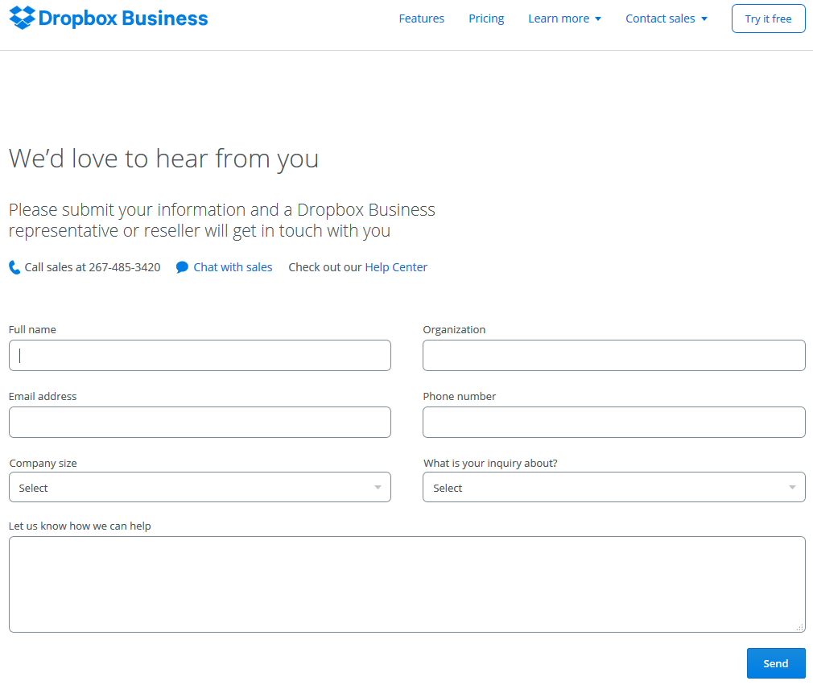
Dropbox Business Account
you won’t be able to send a 5 GB file to a Basic 2 GB account.
Teams start off with 1 TB (1,000 GB) of space per user. Let us know if you need more space, and we’ll increase your storage limit at no additional cost.

Slide 26
Competitive Comparison | Sphere3D | Dell-Compellant | NetApp-FAS | EMC-Isilon
Scale
Maximum Cluster Capacity | Over 500PB | 24PB | 103PB | 20PB
Maximum Volume Size | Over 500PB | 100TB | 100TB | 20PB
Maximum Number of Nodes | 64000 | 8 | 24 | 144
Clusterwide Global Namespace |  | - | - | 
Storage Growth
Smallest Cluster Size | 12 Drives | Not Specified | Not Specified | 36 Drives
Auto Data Balancing |  | - | - | 
Auto Performance Balancing |  | - | N- | 
Data Mobility and Data Migration
Built in data migration capability from heterogeneous storage arrays |  | - | - | -
Built-in sync and share capability between storage systems and end-user devices |  | - | - | -
Cloud integration
Replication with cloud instance |  | - |  | -
Fault Tolerance
Number of Drive Failures Tolerated before losing data access | 50% of Drives (2 from each peer set) | 2 in RAID group | 2 in RAID group | 2 in storage pool
Node Failures Tolerated | Upto 2 | Upto 1 in HA pair | Upto 1 in HA pair | Varies
Replication
Continuous Replication |  |  |  | 
High Performance – Near Sync |  | - |  | -
Seamless integration between Remote Office & Central Data Center Solutions
Data Replication between different storage products |  | - | - | -
Single management between entry NAS, ROBO and cloud based instances |  | - | - | -

