Slide 1


Overland Storage SnapServer Overview
February 2016

Slide 2



Technologies to Power the Next Cloud
APPLICATION Containerization
Containerization technology and application network architecture.
ENTERPRISE
STORAGE
Active, on-line, on-site or cloud based enterprise storage for availability all the time.
Cloud, CONTAINERIZATION, Virtualization and data life cycle management
solutions
Workspace
virtualization
Delivering end-user computing needs by virtualizing entire desktops or workspace.
BACKUP AND
DATA RETENTION
On-line, cloud-based or off-line backup with off-site retention and archive, so data can be
safely retained.
Notes:
Sphere3D founded in 2009 and merged with Overland Storage in December 2014 forming a combined company that is a global provider of hybrid cloud virtualization and data management technology.
By bringing together the best of breed technologies and solutions from Sphere 3D, V3 Systems, Overland Storage and Tandberg Data under the corporate umbrella of Sphere 3D helps us accelerate the delivery of our vision in the industry.

Slide 3
Modernize IT – Lower TCO 60%+ with Sphere3D
3 Year TCO
Line of Business Modernization
57%
88%
2-5X
73%
Application virtualization and mobility
Deliver legacy apps on to latest HW Infrastructure
Move CAPEX to OPEX w/ Hybrid Cloud
LOWER
LOWER
INFRASTRUCTURE COST
LOWER
APP MGMT COST
BETTER APPLICATION SCALING
45%
Workspace Modernization
30%
62%
2-5X
LOWER
BYOD, mobility and workspace virtualization
Workload optimized end-point computing near users
On-demand desktop resource scaling (up or down)
LOWER
INFRASTRUCTURE COST
LOWER
WORKSPACE MGMT COST
BETTER APPLICATION PERFORMANCE
Data Storage Transformation
60%
$0
16X
70%
On-demand enterprise grade hybrid cloud storage
Secured data access, anywhere, on any device
Reduce footprint and cost for active and retained data
LOWER
LOWER STORAGE
INFRASTRUCTURE COST
COST OF CENTRAL MGMT & REPLI SW
FASTER
FILE SHARING SW
AT NO EXTRA COST
Notes:
3

Slide 4
Data Management: Reduce TCO by 70%+
Right Tool for the Right Job (Workload)
  Workload optimized, Location optimized, Performance optimized
Common core capabilities deliver operational simplicity
  Data mobility, Central Management, Hybrid-Cloud Ready
Highly differentiated innovations deliver breakthrough efficiencies
  PeerSet protection (vs. RAID) for scale efficiency
  Block based DynamicRAID for storage efficiency
  Removable storage for data back up infrastructure efficiency
  Tape based archive for large scale data retention cost efficiency
Backed by enterprise-grade worldwide support and services infrastructure
Lowest Effective $/GB
Minimal SW Cost
Lowest operational cost

Slide 5
Sphere3D’s Data Management Portfolio
Optimized for Every Workload
Workload
File Shares
Enterprise Apps
Tech/Engg
Apps
Backup/ Recovery
Data Archiving
Platform
SnapServer XSD
SnapServer XSD
SnapServer XSD
SnapServer XSR, XSD
XSR, SnapCloud
SnapScale
RDX, XSR,
SnapCloud
NEO Series
Performance Optimized
Moderate
IOPS
High
IOPS
High
Transfer Rate
High
Transfer Rate
High
Transfer Rate
Recovery Optimized
Minutes
/Seconds
Seconds
Near Instant
Instant
Hours
Cost Optimized
$$
$$
$$$
$$
$
Common Attributes
Data Mobility Centralized Management Hybrid Cloud Ready

Slide 6
Key Differentiated Positioning
Only storage vendor that offers end to end data management solution
  From data creation in servers and end-user devices to actively shared data to data-at-rest through tape or removable disk drives
Only vendor to deliver a complete, workload-optimized storage portfolio that covers SMB to large enterprise businesses
  From sub-$1K and single digit TB’s to $100K’s and hundreds of PB
  From virtualized scale-up workload to high perf, high throughput workloads
Only vendor to offer deployment options with fully featured NAS on-premise, in the cloud or hybrid – all managed with a single pane of glass management
Only vendor that offers data replication and data synchronization from end-point devices and application servers to shared NAS
  Secured, encrypted and always under central IT control
Only vendor to offer app and workspace virtualization, and enterprise data delivery under one umbrella, with TCO saving of 50% or more

Slide 7
Data Storage Transformation – Lower TCO by 70%
3 Year TCO
On-demand enterprise grade hybrid cloud storage
Secured data access, anywhere, on any device
Reduce footprint and cost for active and retained data
70%
LOWER
60%
$0
16X
LOWER STORAGE
INFRASTRUCTURE COST
COST OF CENTRAL MGMT & REPLI SW
FASTER
FILE SHARING SW
AT NO EXTRA COST
Notes:
7

Slide 8

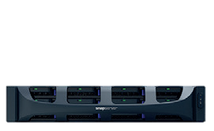
Snap Storage Portfolio – Optimized for Every Workload
Saves Time & Resource
Unified Management: Online, Integrated, user experience focused
SSM (SnapStorage Manager) – Device Discovery & Management
Standardize User Exp.
Consistent Functionality
Unified
Failure Resilient
Snapshots
Integrated DR
Secured Sync and Share
Perf.
Optimized
Desktop Storage
Enterprise Apps
Technical Apps
Enterprise Apps
Storage
Optimized
SnapServer XSD
SnapServer XSD
SnapServer XSR
SnapScale
SnapCLOUD
Specialized Functions
File Shares
Quiet
Economical
Scale-up
Low latency
Expandable storage
Scale-out
Self-learning
Self-healing
Cloud NAS Share
Cloud DR
Sync and Share

Slide 9
Start Anywhere with Any Snap Storage Product
Cloud storage
Desktop storage
CLOUD
SMALL/HOME OFFICE
SNAPSERVER
XSD
PRINT
SERVER
SNAPCLOUD
MOBILE
On-premise storage
SNAPSERVER
EMAIL
SERVER
MEDIUM OFFICES
Scaled NAS storage
On-premise storage
ENTERPRISE
SNAPSCALE
MEDIA
SERVER
SNAPSERVER
VIRTUAL
MACHINE

Slide 10

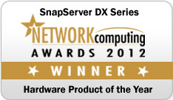






An Enterprise Hardened Award Winning Solution
Software Defined Storage delivered as On-Premise or in-the-Cloud solution
A worldwide leader in entry level enterprise unified (file and block) storage solutin
Over 300,000+ enterprise deployments
Used by more than half of the Fortune 500
Honored with more than 80 industry product awards

Slide 11


Core Value Prop: Peace Of Mind
Data is always protected for business continuity
  SnapShot and replication features ensure data availability
  SnapSync ensures fast sync and share with end-user devices and NAS
  SnapCLOUD enables cloud based NAS, hybrid cloud or DR
“Set it and forget it” automation
  Automated data protection, and data synchronization from mobile or desktop devices, from application servers or from other SnapStorage
  Centrally manage all the instances of Snap Storage on-premise or in the cloud
Enterprise-class, worldwide phone call support available 24x7
  Advance replacement standard with every OVRL configuration

Slide 12






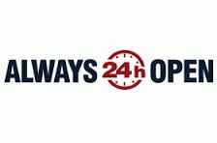
Overland Storage – Replication Technologies
SnapEDR
  Server to Snap, Snap to Snap; 10,000’s of files; Schedule based
  Distributed Enterprise … Replication (1:1, N:1) & Distribution (1:N)
SnapECR
  Snap-to-Snap, Continuous data protection; millions of files
  delta-only changes for bandwidth saving and higher performance,
SnapSync
  End-user devices to Snap, Snap to Snap, Periodic copy (no DR)
  Sync, Share and Access files from anywhere, on any device

Slide 13
Replication Technologies on Snap Storage
 | SnapEDR Enterprise Data Replication | SnapECR Encrypted Continuous Replication | SnapSync Enterprise File Sync & Share
Snap Storage Supported | SnapServer SnapScale SnapCLOUD | SnapServer SnapScale SnapCLOUD | SnapServer SnapScale SnapCLOUD
Workload Most Suited | Distributed Enterprise Many to One, and server- to-Snap replication | Business Continuity Continuous Replication between Snap Storage | Data Mobility Across Users and Devices
Primary Differentiated Use Cases | Scheduled Replication between multiple platforms for Backup | Near Continuous Replication between Snap Storage for Disaster Recovery | Sync, Share and Collaborate on files and folders across users and devices

Slide 14
Replication Technologies – Key Technical Specifications
 | SnapEDR Enterprise Data Replication | SnapECR Encrypted Continuous Replication | SnapSync Enterprise File Sync & Share
Snap Storage Supported | SnapServer SnapScale SnapCLOUD | SnapServer SnapScale SnapCLOUD | SnapServer SnapScale (Q2 2016) SnapCLOUD
OS Platforms Supported | Windows, Linux, Unix, Mac OS, Guardian OS | Guardian OS (SnapServer) Guardian OS (SnapCLOUD) RainCloud OS (SnapScale) | Windows, MAC, Android, iOS
Encrypted | Yes | Yes | Yes
Uses Changed Block Tracking | No | Yes | Yes
Only Changes Replicated | Yes | Yes | Yes
Optimum Work Load | Smaller # of files | Any number of files | Any number of files
Performance | ? | ? | ?
Scheduling | Full | Bandwidth usage control Time scheduling (future) | Selective Sync (not time schedule based)
Preserve Folder Permissions | Yes | Yes | No

Slide 15
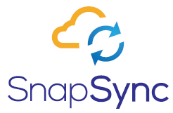





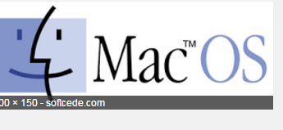
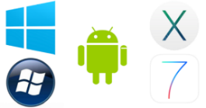

SnapSync™- A Private Storage Cloud for File Sync & Share
Deployed on SnapServer or SnapCLOUD
SMB’s to Large Enterprises
Get data On-The-Go
  Access files from anywhere on any device
Collaborate securely
  Sync & Share data securely
Centralized IT control
  Data managed by IT & Automatically protected
cost effective, high performance solution

Slide 16


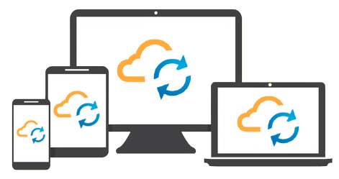

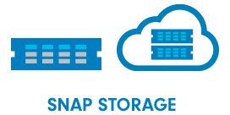


SnapSync – Customer Value Proposition
Get data On-The-Go
Collaborate Securely
Centralized IT Control
Available anywhere on any device
Available on Android, iOS, Windows, & Mac OS
Sync and share your data securely
Owner approval for re-shared folder links
Data Managed by IT & Automatically Protected
Shared data on Enterprise class on-premise NAS or private VM in SnapCLOUD

Slide 17
Partner Benefits with SnapECR
  Extends the SnapServer solution to a broader market
    Distributed Enterprise requiring high performance replication and/or continuous replication
  SMB’s & Enterprises deploying a Hybrid Cloud Data Management solution
    Deployment with ease and at a cost effective price point – Using SnapServer/SnapScale (on-premise) and SnapCLOUD (MS Azure Cloud)
  Business Continuity with data changes continuously replicated
    DR for SMB’s and Enterprises at a lower cost

Slide 18
SnapServer XSR/XSD
Core Features | Function | Benefits
Enterprise-grade Unified Storage solution with file (NFS, SMB/CIFS) and block (iSCSI) protocol, and native Microsoft AD integration | Robust enterprise grade unified storage appliance scales up from 2TB to 786TB. Integrates seamlessly, including mixed (Unix/Windows) permissions in a MS Active Directory domain. | Either SMB, a ROBO or a large corporate workgroup, SnapServer meets need for all From shared storage to enterprise application, SnapServer does it all, including mixed workload Seamless integration in corp IT including hybrid cloud across Unix/Linux and windows users
Built in resiliency with DynamicRAID technology with data tiering and mixed drive support | Create, grow and shrink volumes for users or groups dynamically. Support tiered storage with mix of SSD and SATA. Mix drive sizes without sacrificing capacity | Maximize your storage efficiency by granularly allocating and utilizing your capacity across drive types and sizes – no wastage Overprovision and optimized per workload perf
Built-in near synchronous data replication for business continuity | Copy your original data and subsequent changes to another Snap family appliance using the built-in parallel replication engine. Set up granular backup scheduling as needed- hourly, daily, etc. | Enjoy peace of mind with data availability in case of system or site failure. No additional cost for the replication feature means you save thousands of dollars in SW cost
Build a hybrid cloud with SnapCLOUD | Integrate and replicate data on to SnapCLOUD, and ensure business continuity and DR against site level failure. | Cloud based DR with SnapCLOUD. Common features and tools across Snap family reduce complexity and cost of managing a hybrid cloud.
Set up a private cloud with SnapStorage Manager and SnapSync | Centrally manage all the Snap family appliances with SnapServer Manager. Securely Sync and share files between end-users and devices. | Keep all your corporate data in your control and protected in a private cloud. Sync and share data with users and their devices with Dropbox like simplicity but not cost.

Slide 19
Competitive Positioning

Slide 20
Competitive Positioning Against QNAP/Synology
Customer Requirement | Overland Storage (OVRL) | QNAP/Synology
Data Replication | Real-time, near-synchronous, high speed and comprehensive - Server to Snap, End-points to Snap or Snap-to-Snap | Not all models of QNAP support real time back up. Maximum backup jobs are limited to 32. Synology supports only one remote backup task.
Need advance replacement in case of a failure. | If the primary device fails, OVRL will replace the device in 4 hours or the next business day (per the support contract) | No advance replacement. Failed device must be shipped back to the vendor’s factory. Replaced only if problem found
Data must be available all the time. | In case of downtime, customer app can fail over to a DR (Disaster Recovery) copy of the data in the cloud or another site, so the apps and employees do not experience downtime. | No cloud based DR. Application servers cannot access the data in case the primary site fails. They only provide connector to backup data to public cloud.
Need customer support 24x7. | OVRL offer 24x7 phone support, along with advance replacement. | Customer support is off-loaded to a user forum or email only support with the vendor. No phone support.
Secure sync, share and collaborate w/ devices and users | With SnapSync users can securely and selectively sync & share files and folders with other devices and users via encrypted key access. | Enterprise class central sync and share not possible. No selective sync to avoid data bloat on mobile devices. No permission cascading. No IT controlled license and access management.

Slide 21
Competitive Landscape – Like for Like Comparison is Critical
Product/Features | OVRL | QNAP | Synology
Desktop | XSD 40 | TS-453 Pro | RS415+
Entry 4-bay | XSR 40 | TS-453U-RP | RS815+
Performance 12-bay | XSR 120 | TS-EC1280U-RP | RS3614+
Ensure config choices include CPU, memory configuration parity
Focus on enterprise use case and differentiation
  E.g. media server integration etc., is not our focus
Best to lead with diskless configuration in price sensitive deals
Leverage SnapSync and SnapCLOUD to show stronger contrast
Use enterprise support, advance replacement as a major difference

Slide 22
System Configuration Comparison
Technical Component Comparison
 |  | Synology |  |  | Synology |  |  | Synology | Synology
 | XSD 40 | DS415+ |  | XSR 40 | RS815+ |  | XSR 120 | RS3614xs+ | RS2416RP+
Form factor | Desktop | Desktop |  | Rackmount, 1U | Rackmount, 1U |  | Rackmount, 2U | Rackmount, 2U | Rackmount, 1U
Processor | Intel Atom | Intel Atom |  | Intel Atom | Intel Atom |  | Intel Xeon | Intel Xeon | Intel Atom
Model # | D525 | C2538 |  | D525 | C2538 |  | E3-1220 V2 | E3-1230 V2 | C2538
Launched | Q2'10 | Q3'13 |  | Q2'10 | Q3'13 |  | Q2'12 | Q2'12 | Q3'13
Architecture | 64-bit | 64-bit |  | 64-bit | 64-bit |  | 64-bit | 64-bit | 64-bit
Base Frequency | 1.8 GHz | 2.4 GHZ |  | 1.8 GHz | 2.4 GHZ |  | 3.1 GHz | 3.3 GHz | 2.4 GHZ
Cache | 1 MB | 2 MB |  | 1 MB | 2 MB |  | 8 MB | 8 MB | 2 MB
Lithography | 45 nm | 22 nm |  | 45 nm | 22 nm |  | 22 nm | 22 nm | 22 nm
# of cores | 2 | 4 |  | 2 | 4 |  | 4 | 4 | 4
# of threads | 4 | 4 |  | 4 | 4 |  | 4 | 8 | 4
Memory Type | DDR3 800 | DDR3 1600 |  | DDR3 800 | DDR3 1600 |  | DDR3 1333/1600 | DDR3 1333/1600 ECC | DDR3 1600
Memory | 2 GB | 2 GB |  | 4 GB | 2 GB |  | 4 GB | 8 GB | 2 GB
TDP | 13 W | 15 W |  | 13 W | 15 W |  | 69 W | 54 W | 15 W
Power Supplies | Single | Single |  | Single | Single |  | Dual | Dual ( 2 x 500W) | Dual ( 2 x 500W)
Connectivity
USB 2.0 | 2 | 1 |  | 2 | - |  | 2 | 2 | 2
USB 3.0 | 2 | 2 |  | 2 | 2 |  | 2 | 2 | 2
eSATA | - | 1 |  | - | 1 |  | - | - | -
Ethernet | 2 x 1GbE | 2 x 1GbE |  | 2 x 1GbE | 4 x 1GbE |  | 2 x 1GbE | 4 x 1GbE | 4 x 1GbE
Drives Supported | 3.5" SATA-II HDD | 3.5" SATA-III/II HDD |  | 3.5" SATA-II HDD | 3.5" SATA-III/II HDD 2.5" SATA-III/II HDD 2.5" SATA-III/II SSD |  | 3.5" SATA-II HDD 3.5" SAS 2.0 HDD SSD | 3.5" SATA-III/II HDD 2.5" SATA-III/II HDD 2.5" SATA-III/II SSD | 3.5" SATA-III/II HDD 2.5" SATA-III/II HDD 2.5" SATA-III/II SSD
 | 4 Drives | 4 Drives |  | 4 Drives | 4 Drives |  | 12 Drives | 12 Drives | 12 Drives
 | up to 8TB | up to 8TB |  | up to 8TB | up to 8TB |  | up to 8TB | up to 8TB | up to 8TB
Expansion Units | None | None |  | 3 | 1 |  | 7 | 2 | 1
Max Capacity | 32 TB | 32 TB |  | 128 TB | 64 TB |  | 768 TB | 288 TB | 192 TB
Targeted at | Small Business | Workgroup / SMB |  | Workgroup / SMB | Workgroup / SMB |  | Large Enterprises | Large Enterprises | Workgroup / SMB

Slide 23
SnapServer XSD/XSR vs HP StoreEasy
Overland Storage Advantage | SnapServer XSD/XSR (running GuardianOS) | HP StoreEasy NAS (Running Windows Storage Server OS)
Right priced (40-50% lower) | XSR40/120 Diskless - $1098/ $3964 16TB - $2,139/$5503 | Diskless - $4838 (PCNation) 16TB -$10,597 (CDW) | SnapServer delivers industry’s best price/performance value for an entry level enterprise NAS storage needs
Enterprise sync and share w/ multiple device and users | SnapSync | MS Work Folders | Work folders are limited to single user and multiple devices. No encrypted key management or multi-user sharing
Hybrid cloud ready – Cloud base DR and Backup | YES w/ SnapCLOUD on MS Azure Cloud | Not Included | With HP : Extra $ and complexity, Add-on third party SW – LiveVault –required
Integrated replication | YES | Not Included | With HP : Extra $ and complexity as a -Third party SW – Double Take DR – is required for DR
Data migration tool built-in | YES | Not Included | With HP : Extra $ and complexity, Add-on SW – Double Take - Migrate –required
Single Pane of Glass manageability between Scale-up and Scale-out | YES | Not Possible (No interop between disparate offerings from HP) | SnapServer Manager enables a single pane of glass management across different workload optimized storage solutions

Slide 24
Replication Use Cases

Slide 25
Distributed Enterprise
Replication & Distribution
Agent based solution – Supports multiple platforms
Key architectural attributes
  Byte level incremental
  Bandwidth throttling
  Compression
  Encryption
Replication modes
  Replication (1:1 or N:1)
  Distribution (1:N)
  Remote backup (replication with versioning)
Centralized Management
  Policy based replication
VMware Support
Distributed Enterprise

Slide 26

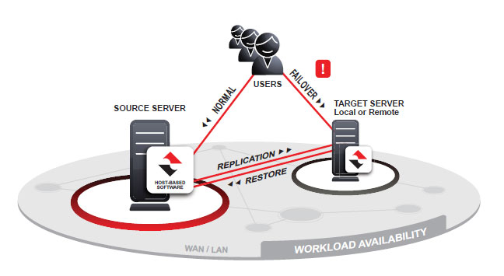
ECR – Encrypted Continuous Replication
ECR = Point-to-Point near continuous replication over an encrypted connection
Supported on SnapStorage platforms
Replication performance compared to EDR
  Higher especially for workloads containing millions of small files
Replication
  Byte level incremental
  Bandwidth throttling
  Encryption
Replication modes
  Replication (1:1 or N:1)
Managed from the Source

Slide 27
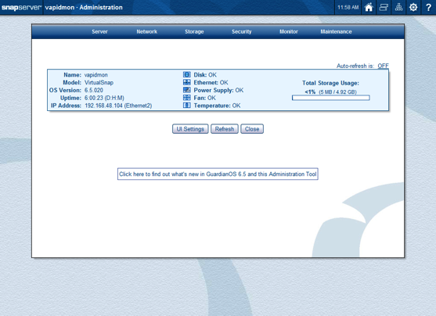
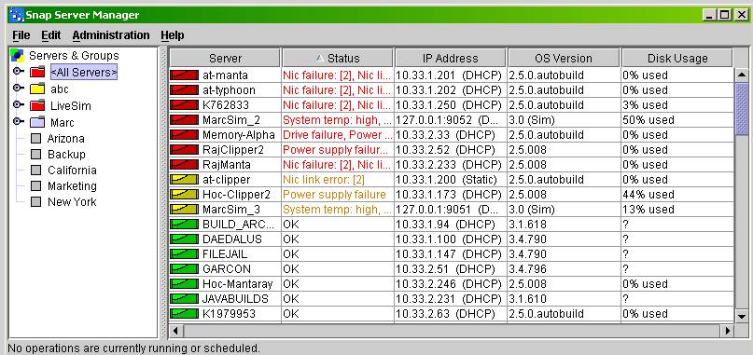
SnapServer Powered By GuardianOS
Software Defined Storage Operating System
Management Interface
Web-based GUI • SSH-based Command Line Interface (CLI)
Centralized Discovery and Management
SnapServer Manager (SSM)
Cross-Platform File Services
SMB/CIFS • NFS • AFP • FTP/S • HTTP/S
Virtualization Ready
iSCSI • VMware Certified • Citrix Certified
Integrated Data Services
RAID • High Performance Snapshots • Replication • Data Import
Native Windows & Linux Integration
Active Directory Services • VSS/VDS • MPIO • NIS • LDAP
Built-in replication for Disaster Recovery
SnapEDR• SnapSync • RDX Backup • Tape Backup • UPS Integration
And much more…

Slide 28
SnapServer® with GuardianOS®
Feature | Function | Benefit
Unified file/block, NAS/SAN | Files, VMs, databases / Structured and unstructured | One destination for all your applications
Scalability | 2TB to 768TB | Scale as you grow, no forklift upgrades
Tiering | Mixing flash and SATA Different data drive speeds and capacities | Optimized for price/performance Mixed workload support – avoids silos
Thin Provisioning | Over provision | Dynamic space allocation
Dynamic RAID | Mix drive sizes | Upgrade hw with high utilization and non-disruptively
Built-in Replication | High speed copy data for secondary storage Encrypted replication between systems and sites | Always on, business continuity, no additional cost No VPN needed
Native Active Directory Integration | The only non-Windows NAS w/ native AD permissions Emulate a Windows security environment by syncing with all of the Windows access control lists | Microsoft Networking users and groups access rights are automatically transferred to the shares Avoids complex integration and interop issues
Snap Manager | Single Pane of glass for management | Reduce operational cost across distributed enterprise
Snap Sync | Encrypted replication of files and folder, Selective sync with bandwidth and space reductions | Secure access to data anywhere, from any device. Network cost savings Access to unlimited data on a limited device memory
Enterprise class Services & Support | Global phone support, Default advanced replacement, 24*7, enterprise class, 4 hour SLA, phone support | Business continuity assurance compared to “ship to factory first” support model by low end suppliers
Data Import | Import data from a competitive, legacy | Save time, money and resources in data migration
High Availability | Operations data shows 5 9s availability | Always on operation, No downtime for 3+ years,
Hybrid Cloud | Extension of on-premise data storage infrastructure | Pay as you go

Slide 29

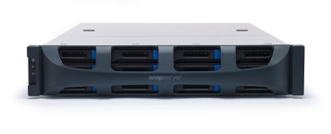
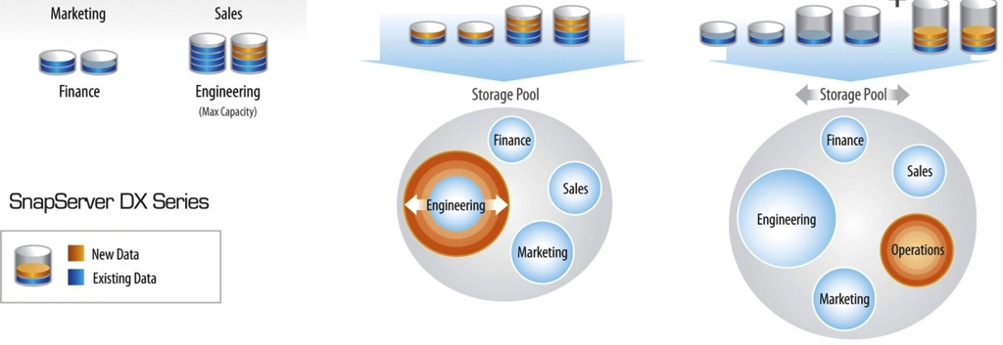
Mix or Replace Hard Drive Capacities
=
With Thinly Provisioned Volumes
Features:
Limitless volume creation in seconds with a few clicks of the mouse
Capacity is easily added to volumes without business disruption or downtime
Volumes can shrink and grow independently – no volume migration
Benefits:
All the benefits of thin provisioning without risk of data loss when real capacity no longer exists
Reduce acquisition costs & manage growth through “just-in-time” storage acquisition
Improve – even double – storage utilization

Slide 30
SnapServer Competitors
 | Sphere3D XSD/R | Dell NX-Series | Synology 2415/1416 | NetApp FAS2520
System
Max Capacity | 768TB | 192TB + SAN expansion | 144TB | 576TB
Entry price point | Sub $1000 | $3000+ | Sub $1000 | $5000+
Form factor scale | Table top to 2U Rack mount | Rack mount only | Table top to 2U Rack mount | Rack mount only
SOHO/Branch office use case |  | - |  | -
Enterprise use case |  |  |  | 
Noise free / Quite mode operation |  | - |  | -
Storage SW features
Storage operating system | Guardian OS | Windows2012 | Disk Storage Manager | Data ONTAP
High performance snapshot |  | - | - | 
Self Balancing |  | - |  | 
Self provisioning |  | - |  | 
Data Mobility and Data Migration
Built in data migration capability from heterogeneous storage arrays |  | - | - | -
Built-in sync and share capability between storage systems and end-user devices |  | - |  | -
Cloud integration
Virtual primary storage instance in the Cloud |  | - | - | 
Replication
Continuous Replication |  |  |  | 
High Performance – Near Sync |  | - |  | -
Remote & Central Office Solutions
Data Replication between scale up and scale out storage products for distributed enterprise |  | - | - | -
Single management between Scale-out NAS and cloud based instances |  | - | - | -

Slide 31
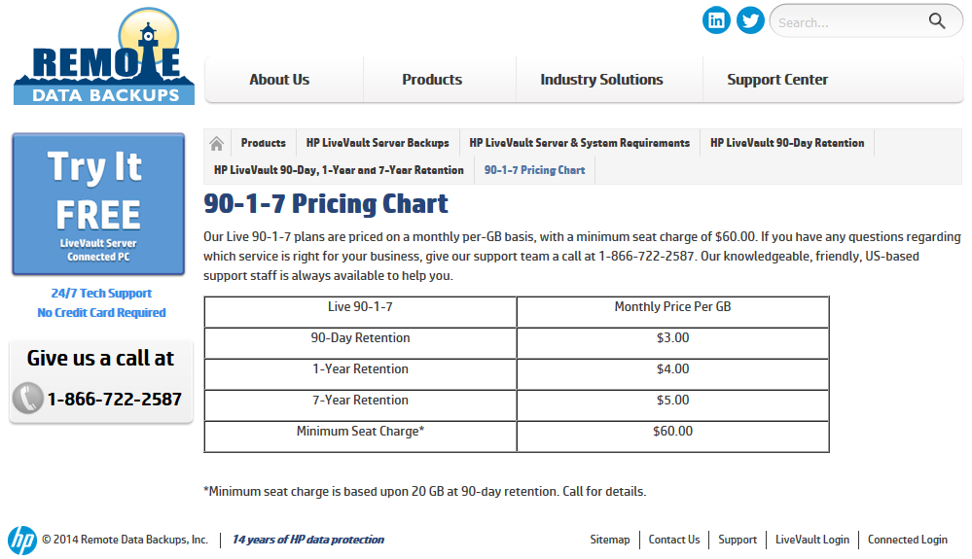
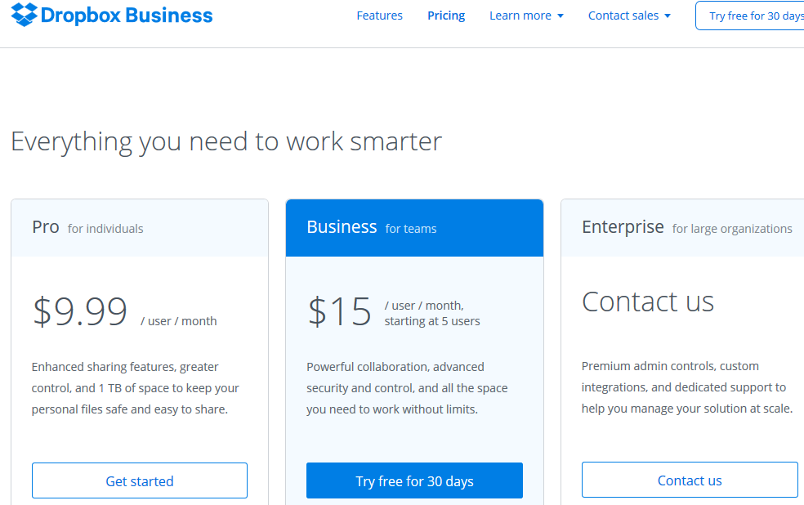
SnapCLOUD vs HP LiveVault and DropBox
 | SnapCLOUD | HP LiveVault | DropBox
Pricing 100 users, 2TB Total (90 days / 1 Year) | $523 / $2093 | $18,000 / $72000 | $4500 / $18,000
Accessible as Windows Share | YES | NO | NO
Fail-over to the Cloud copy | YES | NO | NO
Common management with physical storage | YES | NO | NO
Bi-directional replication | YES | NO | NO
Selective sync and share w/ multiple users and devices | YES | NO | NO* (multiple accounts required)

