Slide 1

Q4 - 2020
Promotions
Name
Title
Overland-Tandberg
email@overtandberg.com
Date, 2020

Slide 2
Mission
Enabling Organizations to Securely Manage and Protect their Digital Assets
Hybrid Cloud Data Management
Digital Assets
IT Transformation
Data Protection
Business Continuity and Backup
Private Cloud
Onsite Infrastructure

Slide 3



Overland–Tandberg
founded
1980
Proprietary Product Design
Protected by a global patent portfolio.
  Increased investment in technology and product development
Worldwide Customer Base
Ranging from Fortune corporations, government, SME and SMB
with over 5+ million systems shipped.
Embarking on a 40 Year History
Trusted Partners
Rich heritage…bright future!
Providing Hybrid Cloud Data Management, Protection and Archive Solutions
Global Company
Technology
Manufacturing
Services
Brands recognized worldwide
Products and Services in
90
countries and growing…

Slide 4



Slide 5


















































Global Installed Base
Over 90 Countries
Financial Services
Technology, Media, Telecommunications
Industrial/Auto
CPG/Healthcare
Government/Education

Slide 6

Q4
PROMOTIONS

Slide 7


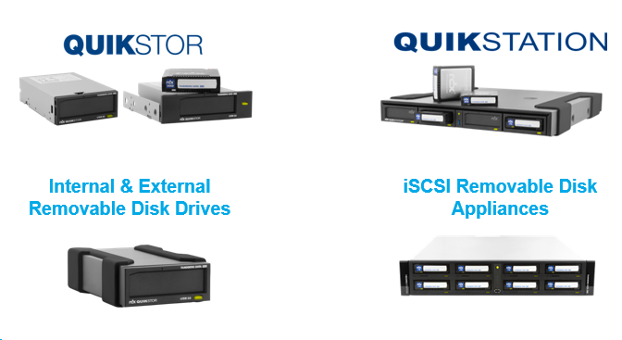
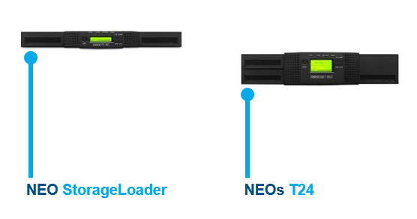
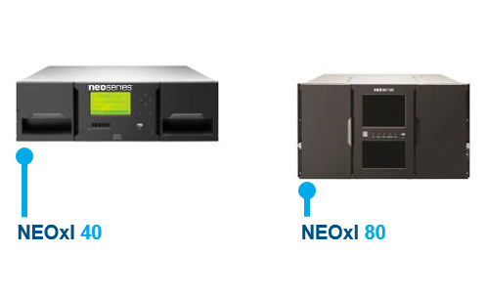

Q4 Promos – Related products
External
Removable Disk Drives & Systems
LTO Ultrium
Tape Automation Libraries
Requires Promo SKUs
HDD, WORM Media

Slide 8
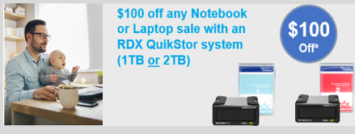
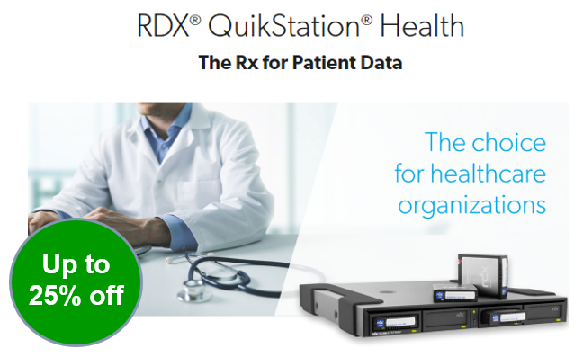
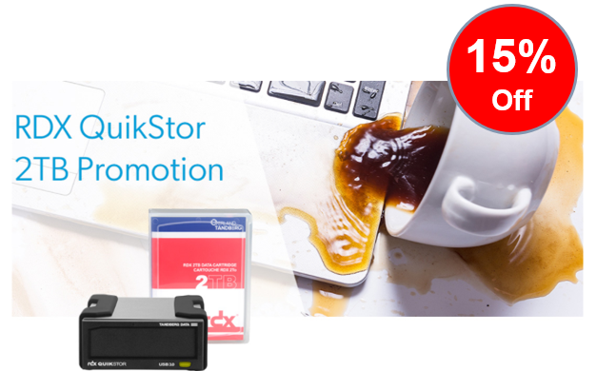

Current q4 promotions
a/o 10/01/20

Slide 9

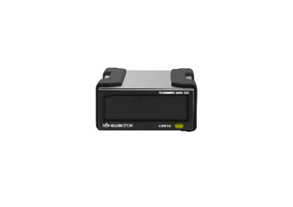
RDX® Quikstor
Business continuity for Today’s Remote Workforce
Business Continuity Made Simple
Target Audience | Dir of IT, IT Managers, Employee Onboarding Leader, Compliance Officer, or MSPs who are enabling today’s Remote Workforce
Segment | Remote and/or Gig Workers, SOHO, SMB, Departmental Users SME/ENT
Solution | The RDX QuikStor removable disk solution fits perfectly in almost environment and takes the worry out of data loss and ensures business continuity.
Benefits | Easy ─ Instant access with easy drag-and-drop control Flexible ─ Manage data lifecycle for backup, DR, and retention Secure ─ Integrates with all leading backup and encryption software, as well as off-site and cloud archiving solutions. Low Cost ─ Overall lowest business continuity cost for remote workers Rugged ─ Knocks and drops don’t mean lost data
5 Million
RDX QuikStor Units Sold WW

Slide 10
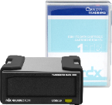
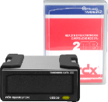
RDX QuikSTOR kit – Sales Tools
RDX QuikStor 1TB Kit
P/N: 8864-RDX
MSRP: $382
RDX QuikStor 2TB Kit
P/N: 8865-RDX
MSRP: $471
$89
Data Sheets
RDX QuikStor Data Sheet
RDX Media Data Sheet
RDX QuikStation ─ Data Sheet
RDX Product Family – Matrix Data Sheet
Case Studies
RDX QuikStor Customer Case Study: Photography Agency/SOHO
RDX QuikStor Customer Case Study: MSP/IT service provider
RDX QuikStor Customer Case Study: Restaurant/Franchise
RDX QuikStor Customer Case Study: Education/K12
RDX QuikStor Customer Case Study: Video Surveillance
RDX QuikStor Use Case: Video & Entertainment
RDX QuikStor Use Case: Hospitality

Slide 11





$100
Off *
PROMO #1
Notebook or Laptop
RDX QuikStor
Attach
Total purchase of NOTEBOOK or LAPTOP (plus)
RDX QuikStor Removable Disk System (1TB or 2TB)
*Requires valid POS – Notebook/Laptop attach
(Offer expires 12/31/2020)
RDX QuikStor 1TB
P/N 8864-RDX
RDX QuikStor 2TB
P/N 8865-RDX
*Questions? (888)343-7627; sales@overlandtandberg.com
© 2020 OVERLAND TANDBERG CONFIDENTIAL

Slide 12
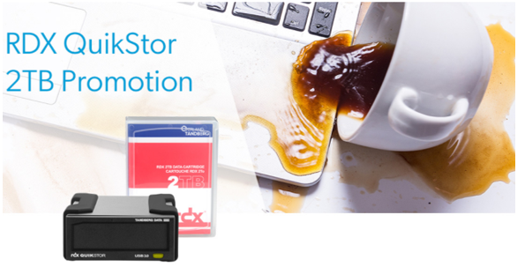
15%
Off *
PROMO #2
RDX QuikStor 2TB
Removable
Backup & Archive
Disk Solution
*Discount is only eligible for POS orders, and cannot be used for stocking orders.
*Questions? (888)343-7627; sales@overlandtandberg.com
Promo Code - MC-36080
[Part#: 8865-RDX ]
Offer expires 12/31/2020
© 2020 OVERLAND TANDBERG CONFIDENTIAL

Slide 13
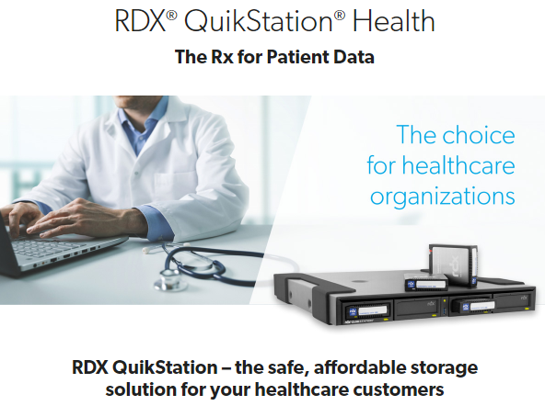
PROMO #3
RDX QuikStation
Removable
Backup & Archive
Disk Solution
Up to
25% off
© 2020 OVERLAND TANDBERG CONFIDENTIAL

Slide 14

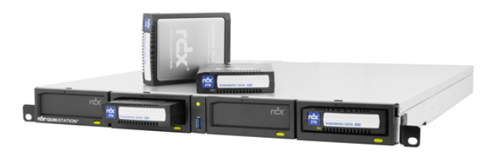


RDX® QuikstATION® ─ Healthcare
Target Audience | IT Managers or Healthcare MSPs supporting small medical practices, small to medium community hospitals and labs
Segment | Any vertical w/ regulatory requirements; Healthcare, Biotech/Pharma, FinSvcs, Manufacturing, FED/SLED
Solution | The RDX QuikStation removable disk system improves patient outcomes by providing comprehensive data storage and protection, archivability, and disaster recovery, that ensure business continuity.
Benefits | Compliant ─ Use with encryption software to support ONC-ATCB requirements for patient privacy and data integrity. Easy ─ Simple setup and remote management. Quickly start protecting electronic health records. Flexible ─ Scalable capacity to store any medical practice data like records, images, administration and research.
RDX QuikStation 4
RDX QuikStation 8

Slide 15
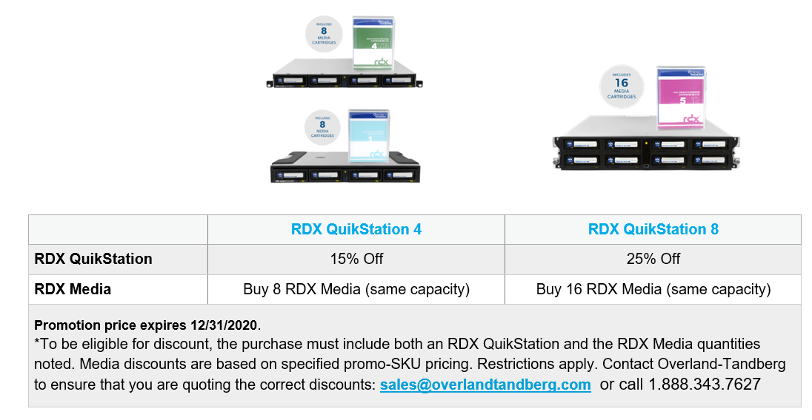

RDX® QuikstATION^{® for} hEALTH
Promo Details
Up to
25% off
RDX QuikStation 4
Rackmount
RDX QuikStation 4
Desktop
(888)343-7627
sales@overlandtandberg.com
Offer expires 12/31/2020

Slide 16
RDX QuikStation
Please remind resellers:
NOTE
Please contact Overland-Tandberg before quoting to your customer the final pricing to insure you’ve selected the correct discounting.
Also any questions, or issues, just email us sales@overlandtandberg.com or call us at 1.888.343.7627.
We’re always here to help!

Slide 17
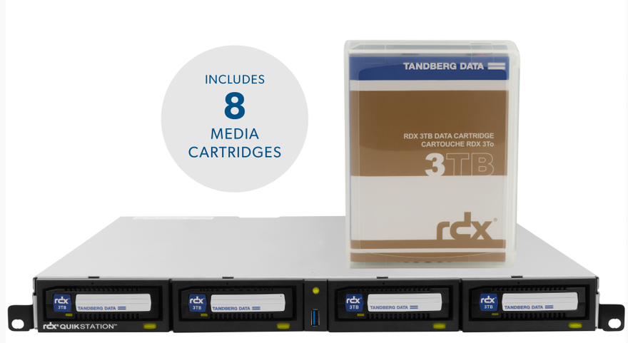
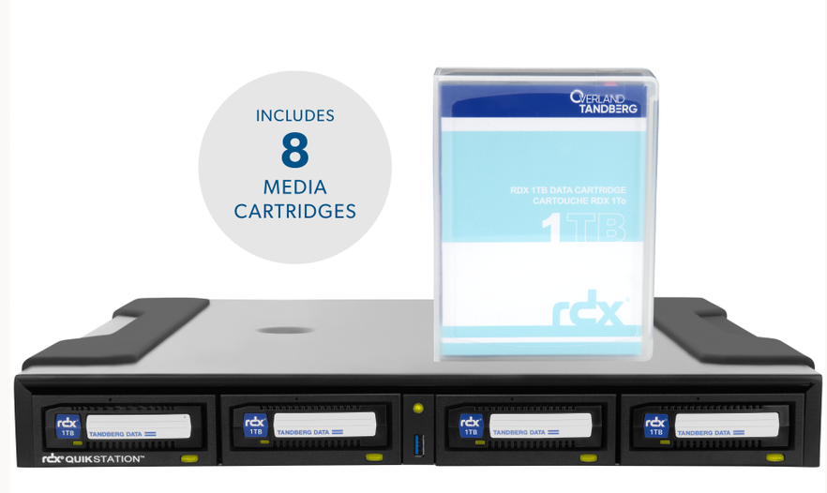
Promo: RDX® QuikstATION - Options
RDX QuikStation 4 plus 8 Media Cartridges
Promotional SKUs
Offer expires 12/31/2020
(888)343-7627
sales@overlandtandberg.com
RDX QuikStation 4 – 1U Rackmount | Media Cartridge Capacity | Media Qty | Promotion SKU
[8920-RDX] - RDX QuikStation 4 RM, 4-Bay, 4x 1Gb Ethernet, removable disk array, 1U rackmount | [8541-RDX] -Tandberg RDX 500 GB Cartridge | 8 | PR-8920-RDX500GB
[8920-RDX] - RDX QuikStation 4 RM, 4-Bay, 4x 1Gb Ethernet, removable disk array, 1U rackmount | [8586-RDX] -Tandberg RDX 1.0TB Cartridge | 8 | PR-8920-RDX1TB
[8920-RDX] - RDX QuikStation 4 RM, 4-Bay, 4x 1Gb Ethernet, removable disk array, 1U rackmount | [8731-RDX] - Tandberg RDX 2TB Cartridge | 8 | PR-8920-RDX2TB
[8920-RDX] - RDX QuikStation 4 RM, 4-Bay, 4x 1Gb Ethernet, removable disk array, 1U rackmount | [8807-RDX] -Tandberg RDX 3TB Cartridge | 8 | PR-8920-RDX3TB
[8920-RDX] - RDX QuikStation 4 RM, 4-Bay, 4x 1Gb Ethernet, removable disk array, 1U rackmount | [8824-RDX] -Tandberg RDX 4TB Cartridge | 8 | PR-8920-RDX4TB
[8920-RDX] - RDX QuikStation 4 RM, 4-Bay, 4x 1Gb Ethernet, removable disk array, 1U rackmount | [8862-RDX] -Tandberg RDX 5TB Cartridge | 8 | PR-8920-RDX5TB
RDX QuikStation 4 – Desktop | Media Cartridge Capacity | Media Qty | Promotion SKU
[8922-RDX] - RDX QuikStation 4 DT, 4-Bay, 4x 1Gb Ethernet, removable disk array, desktop | [8541-RDX] -Tandberg RDX 500 GB Cartridge | 8 | PR-8922-RDX500GB
[8922-RDX] - RDX QuikStation 4 DT, 4-Bay, 4x 1Gb Ethernet, removable disk array, desktop | [8586-RDX] -Tandberg RDX 1.0TB Cartridge | 8 | PR-8922-RDX1TB
[8922-RDX] - RDX QuikStation 4 DT, 4-Bay, 4x 1Gb Ethernet, removable disk array, desktop | [8731-RDX] - Tandberg RDX 2TB Cartridge | 8 | PR-8922-RDX2TB
[8922-RDX] - RDX QuikStation 4 DT, 4-Bay, 4x 1Gb Ethernet, removable disk array, desktop | [8807-RDX] -Tandberg RDX 3TB Cartridge | 8 | PR-8922-RDX3TB
[8922-RDX] - RDX QuikStation 4 DT, 4-Bay, 4x 1Gb Ethernet, removable disk array, desktop | [8824-RDX] -Tandberg RDX 4TB Cartridge | 8 | PR-8922-RDX4TB
[8922-RDX] - RDX QuikStation 4 DT, 4-Bay, 4x 1Gb Ethernet, removable disk array, desktop | [8862-RDX] -Tandberg RDX 5TB Cartridge | 8 | PR-8922-RDX5TB

Slide 18
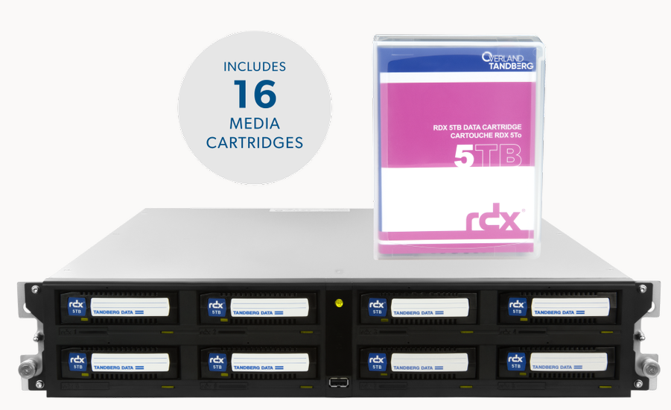
Promo: RDX® QuikstATION - Options
RDX QuikStation 8 plus 16 Media Cartridges
Promotional SKUs
RDX QuikStation 8 – 2U Rackmount | Media Cartridge Capacity | Media Qty | Promotion SKU
[8943-RDX] - RDX QuikStation 8 RM, 8-Bay, 2x 10Gb Ethernet, removable disk array, 2U rackmount | [8541-RDX] -Tandberg RDX 500 GB Cartridge | 16 | PR-8943-RDX500GB
[8943-RDX] - RDX QuikStation 8 RM, 8-Bay, 2x 10Gb Ethernet, removable disk array, 2U rackmount | [8586-RDX] -Tandberg RDX 1.0TB Cartridge | 16 | PR-8943-RDX1TB
[8943-RDX] - RDX QuikStation 8 RM, 8-Bay, 2x 10Gb Ethernet, removable disk array, 2U rackmount | [8731-RDX] - Tandberg RDX 2TB Cartridge | 16 | PR-8943-RDX2TB
[8943-RDX] - RDX QuikStation 8 RM, 8-Bay, 2x 10Gb Ethernet, removable disk array, 2U rackmount | [8807-RDX] -Tandberg RDX 3TB Cartridge | 16 | PR-8943-RDX3TB
[8943-RDX] - RDX QuikStation 8 RM, 8-Bay, 2x 10Gb Ethernet, removable disk array, 2U rackmount | [8824-RDX] -Tandberg RDX 4TB Cartridge | 16 | PR-8943-RDX4TB
[8943-RDX] - RDX QuikStation 8 RM, 8-Bay, 2x 10Gb Ethernet, removable disk array, 2U rackmount | [8862-RDX] -Tandberg RDX 5TB Cartridge | 16 | PR-8943-RDX5TB
Offer expires 12/31/2020
(888)343-7627
sales@overlandtandberg.com

Slide 19
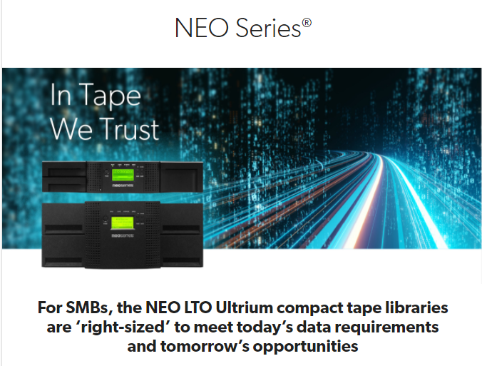
Up to
40% off
PROMO #4
NEO Series
Tape Libraries
© 2020 OVERLAND TANDBERG CONFIDENTIAL

Slide 20
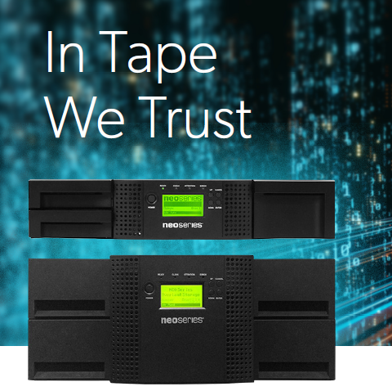
NEO®s T24 │ t48 ─ In Tape We Trust
Audience | CIO, Dir of IT, IT Manager, Storage Admin, MSPs
Segment | SMB/SME ─ All verticals, including Healthcare, FinSvcs, Manufacturing, FED/SLED
Solution | NEOs LTO tape archive solutions improve business efficiency, eliminate costly downtime and deliver the lowest cost of ownership of any storage technology. NEO Series combines large storage capacities with easy-to-use, highly reliable, cost-efficient platform for backup, disaster recover, and long-term offline archiving.
Benefits | Affordable ─ High speed backup/archiving of up to 720TB of data Easy ─ Manage backup/archive processes from anywhere in the world Flexible ─ Add tape drives as needed for increased scalability, performance and enhanced efficiency Secure ─ Protect data against cybercrime and disasters with offline ‘air-gap’ and low-cost replication

Slide 21
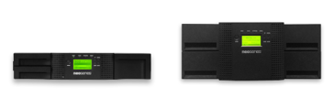
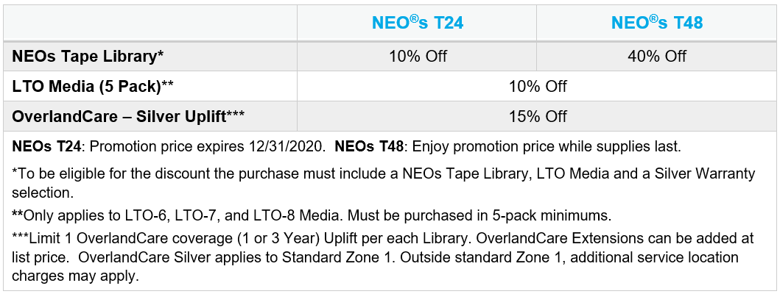
NEO®s T24 │ t48 ─ Promo Details
Up to
40% off
Promo Codes
NEOs T24 - MC-36153
NEOs T48 - MC-36154
Offer expires 12/31/2020

Slide 22
Promo #4 ─ NEOs LTO Tape library
Please remind resellers:
NOTE
Please contact Overland-Tandberg before quoting to your customer the final pricing to insure you’ve selected the correct discounting.
Also any questions, or issues, just email us sales@overlandtandberg.com or call us at 1.888.343.7627.
We’re always here to help!

Slide 23
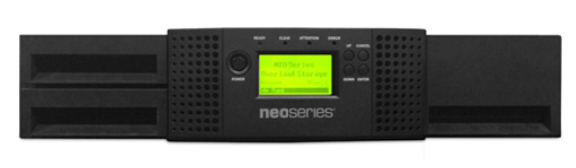
Promotion Details, Terms & Conditions – NEOs T24
Promo Code
NEOs T24 - MC-36153
NEOs T24
Part # | NEO T24 - Tape Library
OV-NEOsT246SA | NEOs T24 2u/24-slot/1-LTO6 SAS/with 1-year Bronze warranty
OV-NEOsT246FC | NEOs T24 2u/24-slot/1-LTO6 FC/ with 1-year Bronze warranty
OV-NEOsT247SA | NEOs T24 2u/24-slot/1-LTO7 SAS/with 1-year Bronze warranty
OV-NEOsT247FC | NEOs T24 2u/24-slot/1-LTO7 FC/ with 1-year Bronze warranty
OV-NEOsT248SA | NEOsT24 2u/24-slot/1-LTO8 SAS/with 1-year Bronze warranty
OV-NEOsT248FC | NEOsT24 2u/24-slot/1-LTO8 FC/with 1-year Bronze warranty
Part # | LTO Media Options (5 pack min.)
434021 | LTO-6 Data Cartridges, 2.5TB/6.25TB, un-labeled w/ case (5 pk min)
434131 | LTO-7 Data Cartridges, 6TB/15TB, un-labeled w/ case (5pk min)
434132 | LTO-8 Data Cartridge, 12TB/30TB, un-labeled w/ case (5pk min)
Part # | OverlandCare Warranty Options
EW-24SLVR1UP | OverlandCare Silver Warranty Coverage, 1-year uplift, NEOs T24
EW-24SLVR3UP | OverlandCare Silver Warranty Coverage, 3-year uplift, NEOs T24
(888)343-7627
sales@overlandtandberg.com
© 2020 OVERLAND TANDBERG CONFIDENTIAL

Slide 24
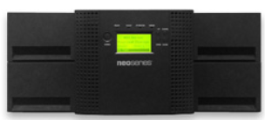
Promotion Details, Terms & Conditions – NEOs T48
Promo Code
NEOs T48 - MC-36154
NEOs T48
Part # | NEO T48 - Tape Library
OV-NEOsT486SA | NEOs T48 4u/48-slot/1-LTO6 SAS/with 1-year Bronze warranty
OV-NEOsT486FC | NEOs T48 4u/48-slot/1-LTO6 FC/with 1-year Bronze warranty
OV-NEOsT487SA | NEOs T48 4u/48-slot/1-LTO7 SAS/with 1-year Bronze warranty
OV-NEOsT487FC | NEOs T48 4u/48-slot/1-LTO7 FC/with 1-year Bronze warranty
OV-NEOsT488SA | NEOsT48 4u/48-slot/1-LTO8 SAS/with 1-year Bronze warranty
OV-NEOsT488FC | NEOsT48 4u/48-slot/1-LTO8 FC/with 1-year Bronze warranty
Part # | LTO Media Options (5 pack min.)
434021 | LTO-6 Data Cartridges, 2.5TB/6.25TB, un-labeled w/ case (5 pk min)
434131 | LTO-7 Data Cartridges, 6TB/15TB, un-labeled w/ case (5pk min)
434132 | LTO-8 Data Cartridge, 12TB/30TB, un-labeled w/ case (5pk min)
Part # | OverlandCare Warranty Options
EW-48SLVR1UP | OverlandCare Silver Warranty Coverage, 1-year uplift, NEOs T48
EW-48SLVR3UP | OverlandCare Silver Warranty Coverage, 3-year uplift, NEOs T48
(888)343-7627
sales@overlandtandberg.com
© 2020 OVERLAND TANDBERG CONFIDENTIAL

Slide 25

resources

Slide 26
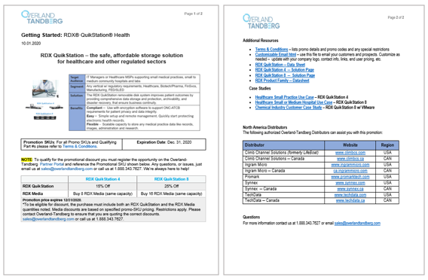
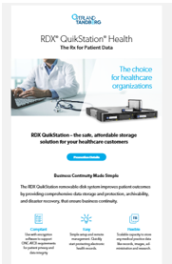
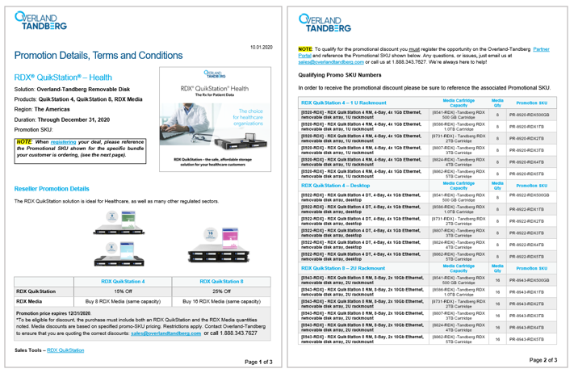
Example ─ Promo Campaign Kits
Customizable HTML
T&Cs
Promo MC Codes or Promo SKUs
Getting Started

Slide 27
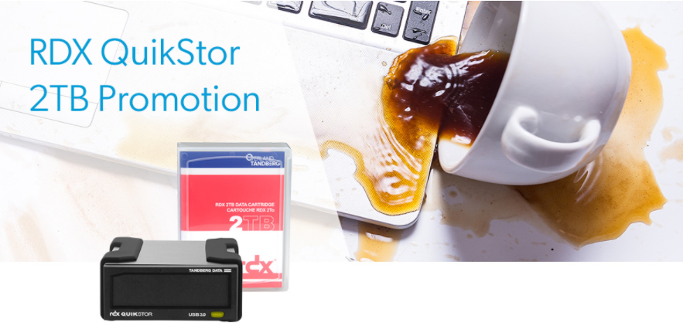
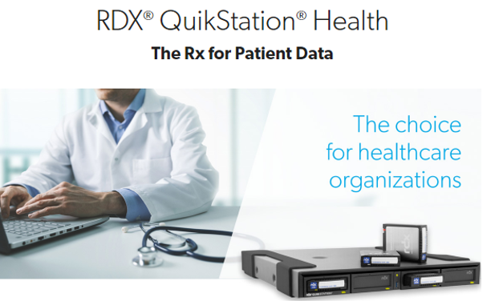

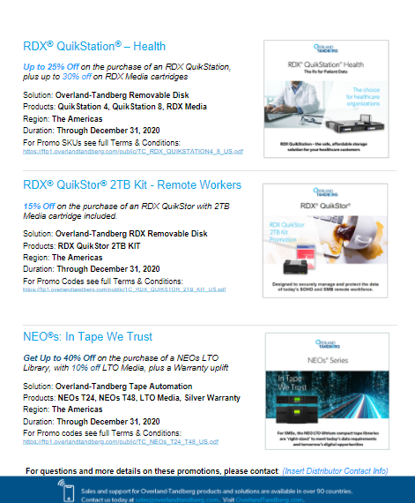
Sales tools (links) ─ Reseller
Promo 1 Pager
Promo 1 RDX QuikStor 2TB Kit
Getting Started
Terms & Conditions w/ Promo Codes
Customizable HTML
Promo 2 RDX QuikStation 4 | 8
Getting Started
Terms & Conditions w/ Promo SKUs
Customizable HTML
Promo 3 NEOs T24 | T48
Getting Started
Terms & Conditions w/ Promo Codes
Customizable HTML

Slide 28
Authorized overland-Tandberg distributors
Distributor | Website | Region
Climb Channel Solutions (formerly LifeBoat) | www.climbcs.com | USA
Climb Channel Solutions ─ Canada | www.climbcs.ca | CAN
Ingram Micro | www.ingrammicro.com | USA
Ingram Micro ─ Canada | ca.ingrammicro.com | CAN
Promark | www.promarktech.com | USA
Synnex | www.synnex.com | USA
Synnex ─ Canada | www.synnex.ca | CAN
TechData | www.techdata.com | USA
TechData ─ Canada | www.techdata.ca | CAN

Slide 29
Overland-Tandberg
Contacts
Inside Sales - Resellers
Jason Rye Account Manager Jrye@overlandtandberg.com 1.408.283.4714 | Eric Paulsen Account Manager epaulson@overlandtandberg.com 1.408.318.3876
Distributor Relations | Partner Marketing
Jeff Hilton Sales Account Manager jhilton@overlandtandberg.com 1.727.608.3441 | Arleen Urquhart Sales GTM & Enablement, Dir. aurquhart@overlandtandberg.com 1.650.455.0577
Pete Peterson SVP, Americas Sales & Strategic Alliances ppeterson@overlandtandberg.com 1.727.643.4758
General Inquiries
1.888.343.7627 sales@overlandtandberg.com
Sales Account Manager
Name Title Name email@overlandtandberg.com 1.xxx.xxx.xxx

Slide 30
Thank You

